Slide 1
Terminal 4 Training
Module 2 | Nov. 2024
Adam Brewer | Kendal Clark

Slide 2
Objectives
Links to PDFs
Update a PDF
Videos
Content Types

Slide 3
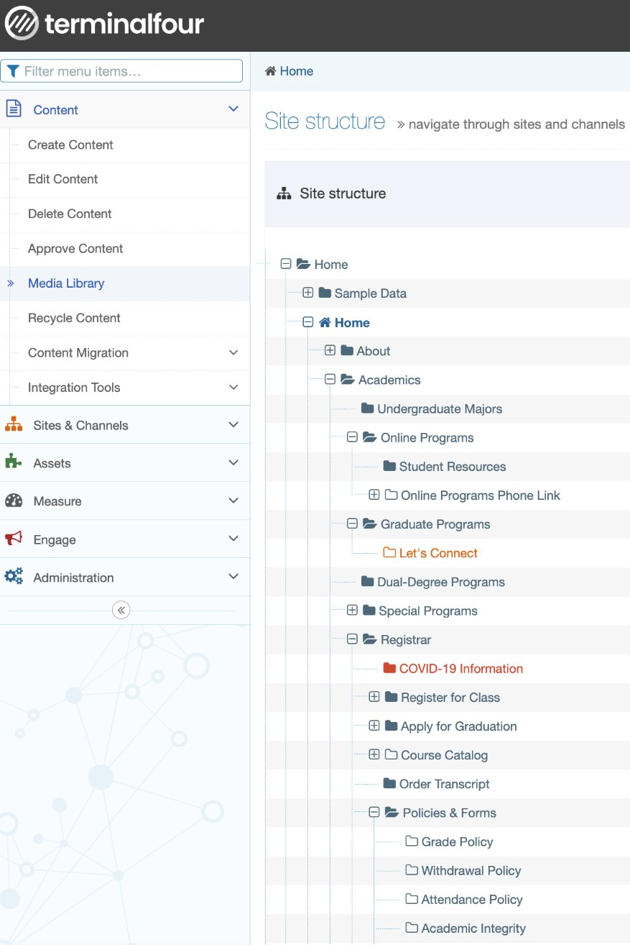
Links to PDFs
1) Open T4
2) Open the Media Library
3) Open the folder where the PDF will live
  (in this example: registrar and forms)
4) Click Add Media
5) Drag the PDF onto the cloud
6) Go to the content piece that needs the PDF in another window
7) Highlight the Words you are linking and click the image square.
8) Search the name of the PDF and click it
9)Save Changes

Slide 4
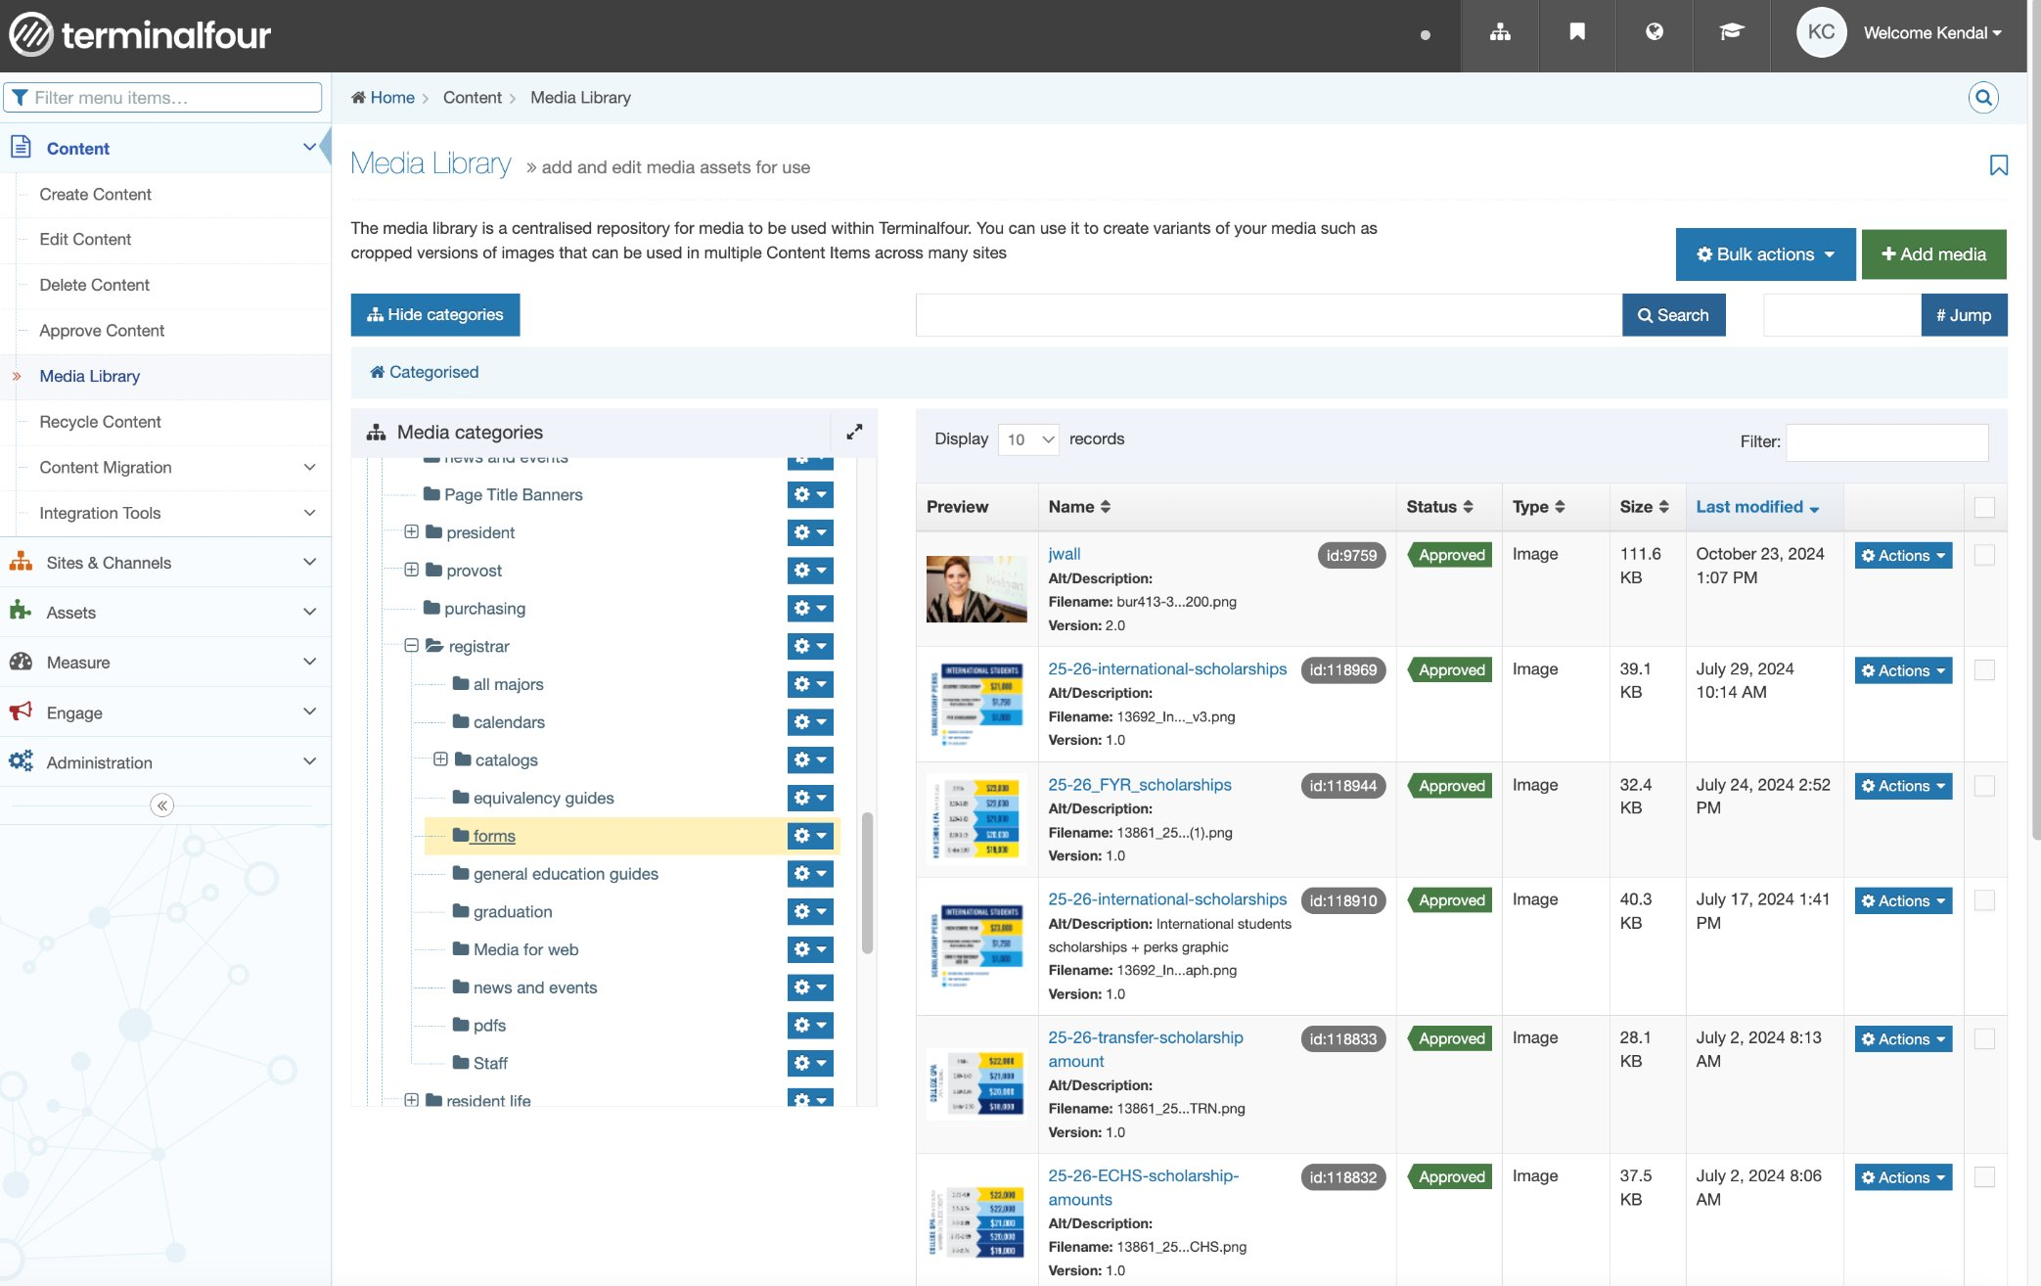

Slide 5
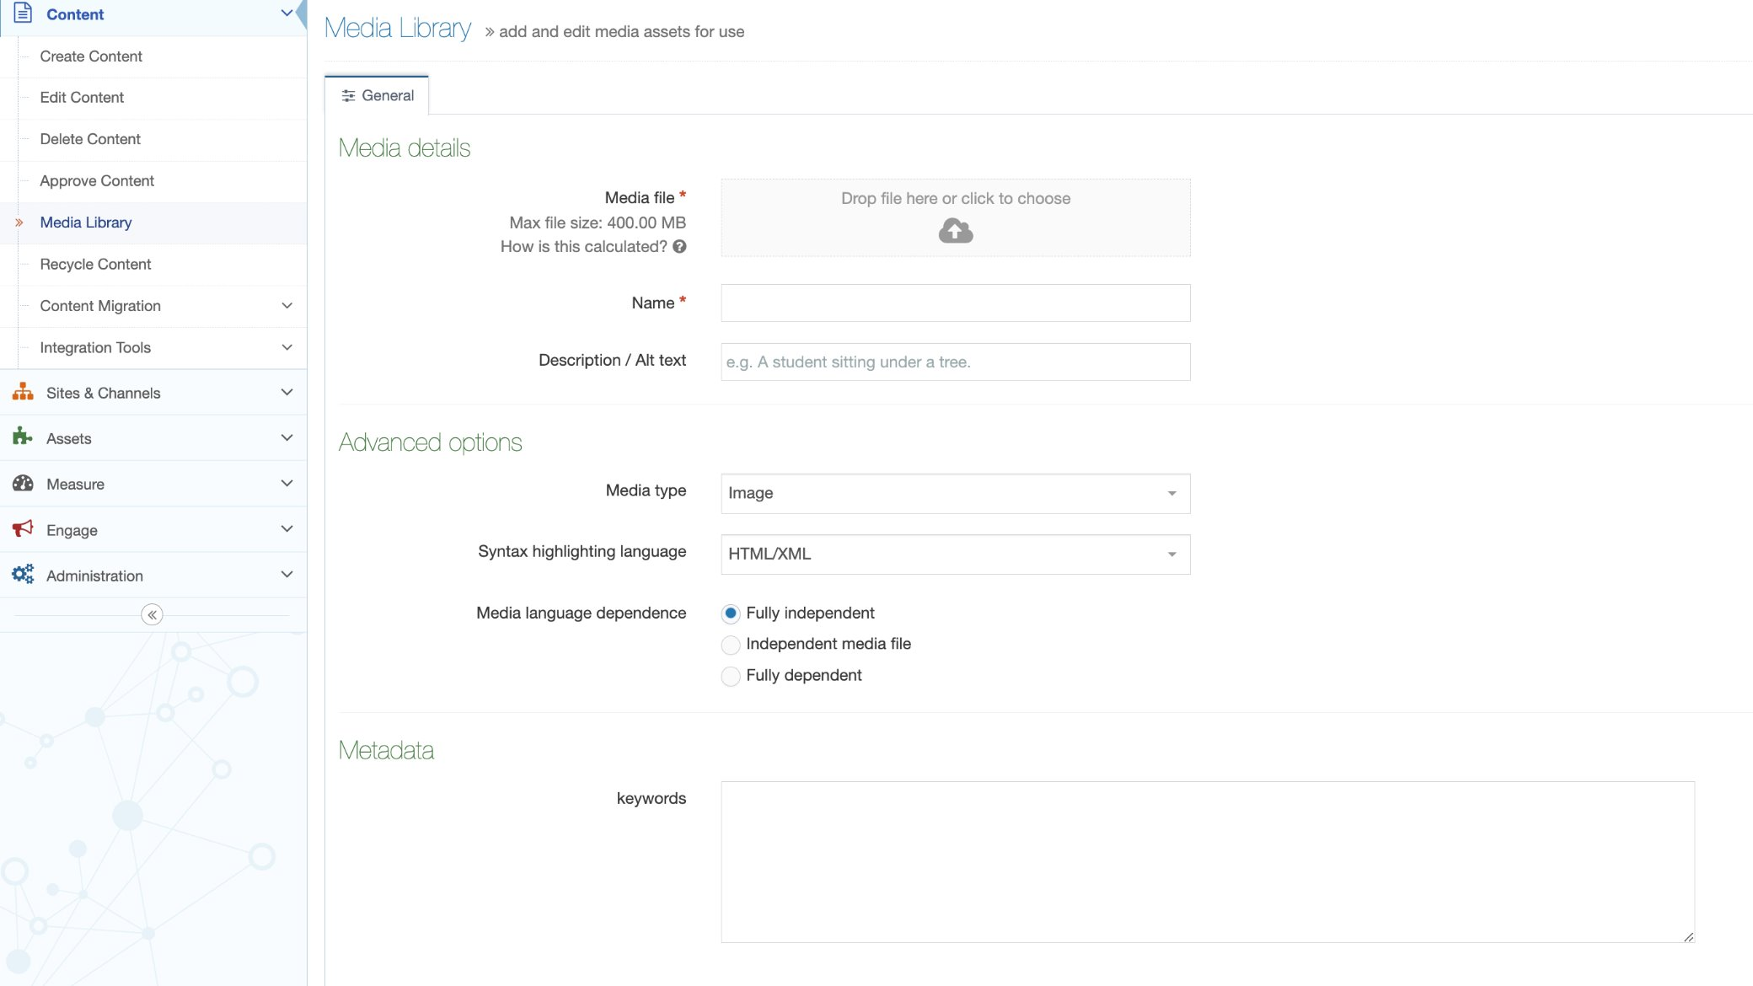

Slide 6
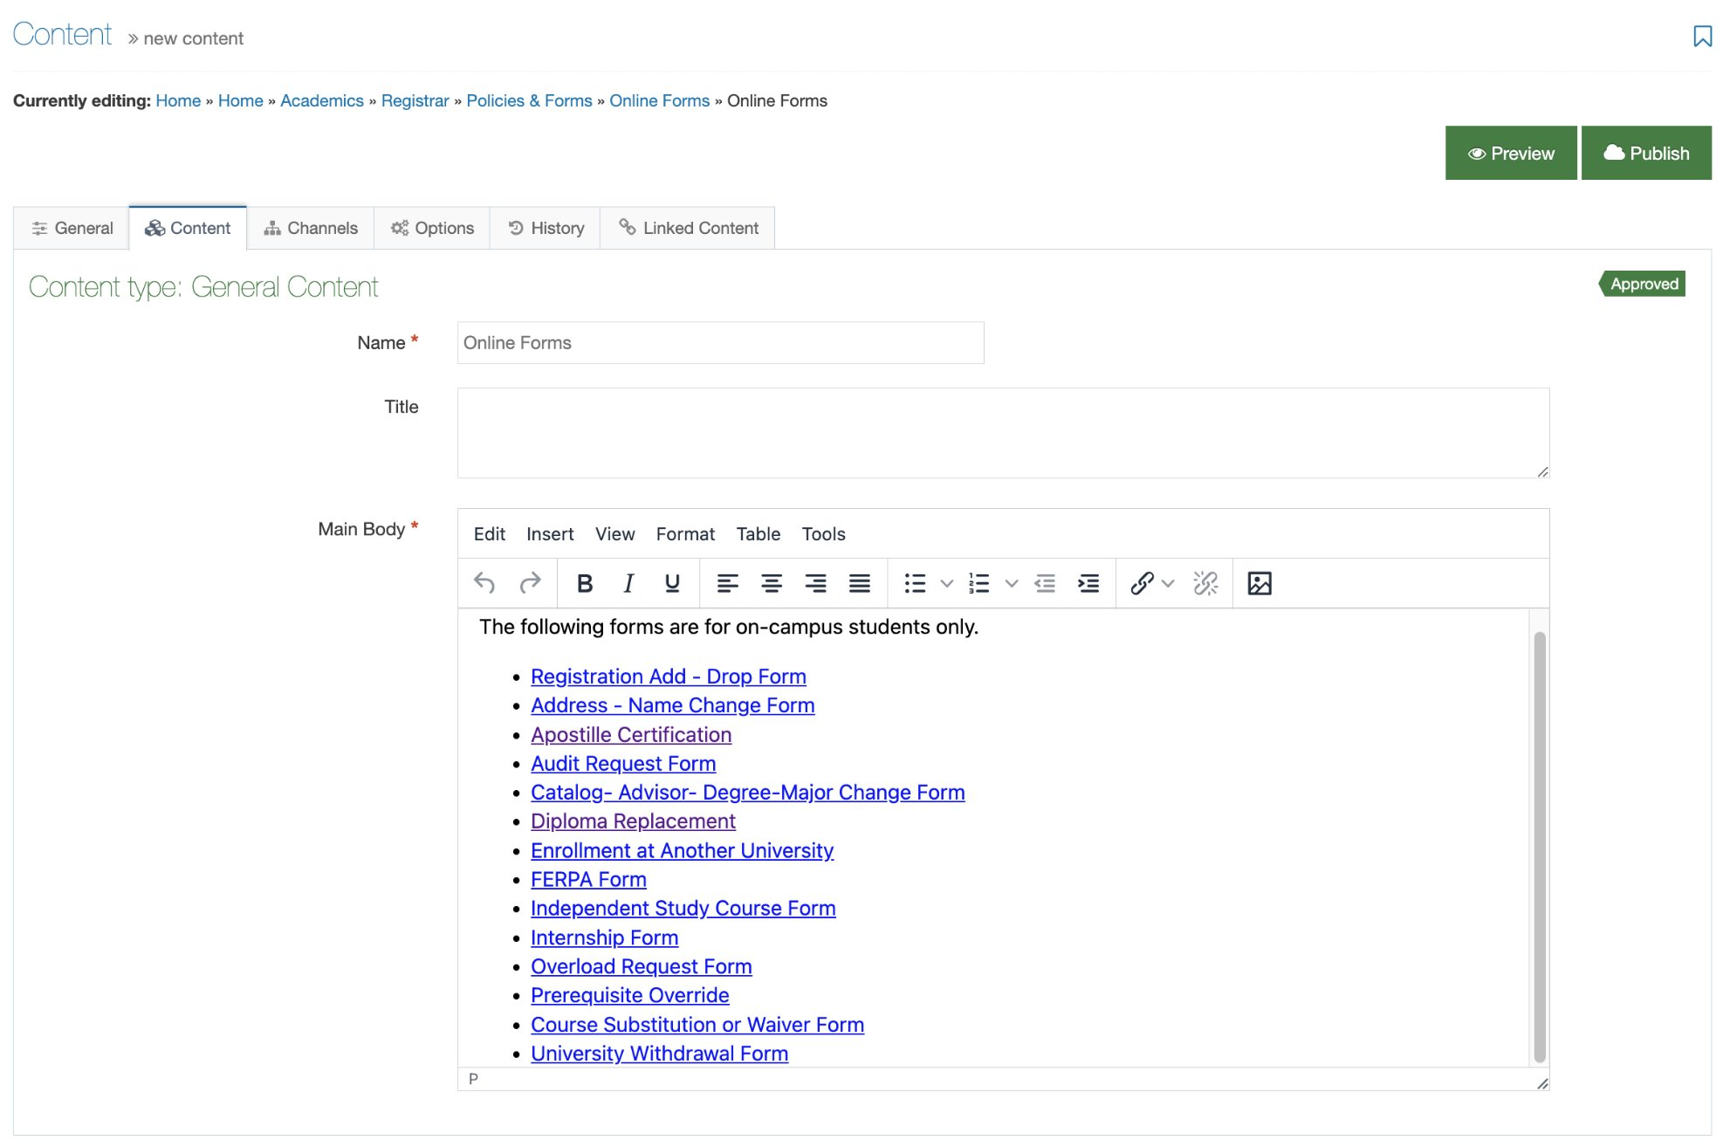

Slide 7
Update a PDF
If you need to update a PDF that already exists in the Media Library, access the Media Library in T4.
Find the PDF utilizing the folders or search bar.
Click the PDF
Drag the new document onto the cloud image, making sure the new PDF has a different name than the old one.
Save Changes

Slide 8
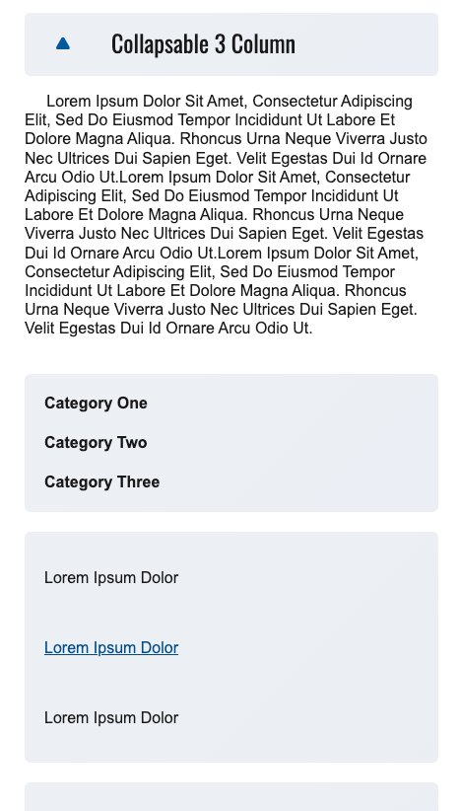
Content Types
Check out this collapsable Content Type!
We try to make content types that are easily accessible on desktop and mobile!
Mobile View

Slide 9
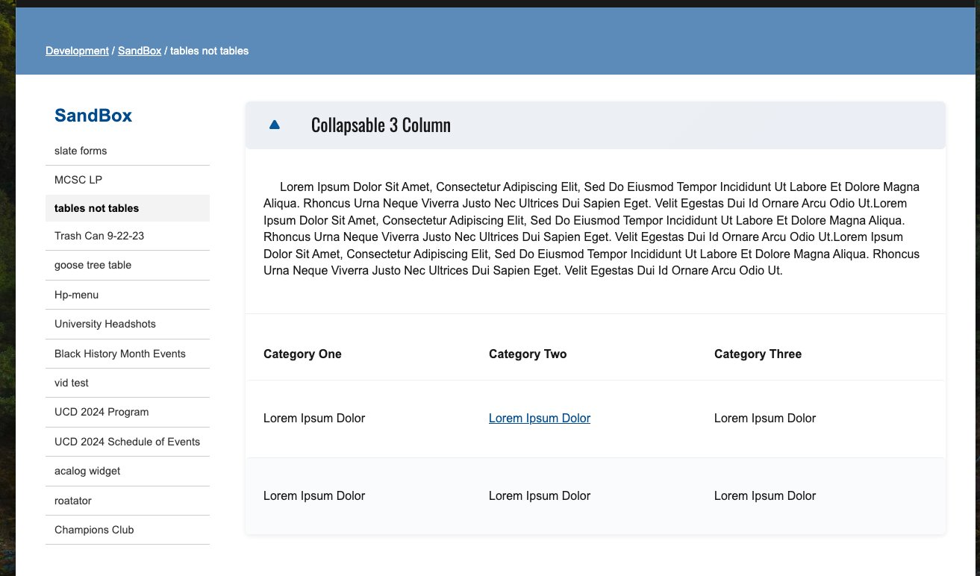
Content Types
Desktop View
Need a new content type?
Want to know if there is one available for something you need on your page?
Let us know!

Slide 10
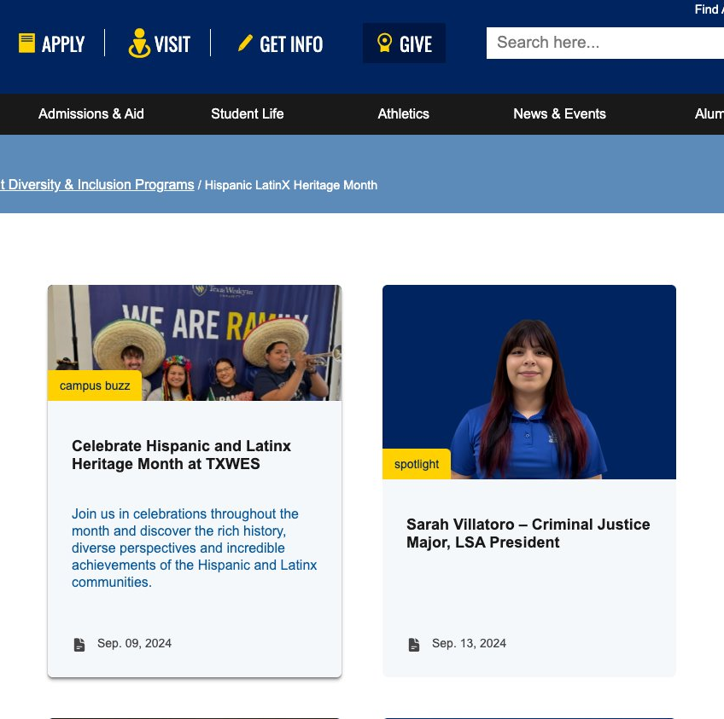
Content Types
More interactive types of stories are available!

Slide 11
Thank You!
Candice Soto
  Project Manager (PWF)
  soto@txwes.edu
Kendal Clark
  SEO & Marketing Specialist
  kdclark2@txwes.edu​
Adam Brewer
  Web Developer
  abrewer@txwes.edu
Have questions?​
We are here for hands-on assistance!​
Contact us or submit a PWF Request​.
You got this!

