Slide 1
Terminal 4 Training
Feb. 2025
Adam Brewer | Kendal Clark

Slide 2
Agenda
T4 Lingo | Symbols & Buttons on Direct Edit
Sub Nav vs Nav | Show in Navigation
Resize Photos in the Media Library
Content Piece Several Photos
New University Photographer
Mobile View vs Desktop
Updates
Questions

Slide 3







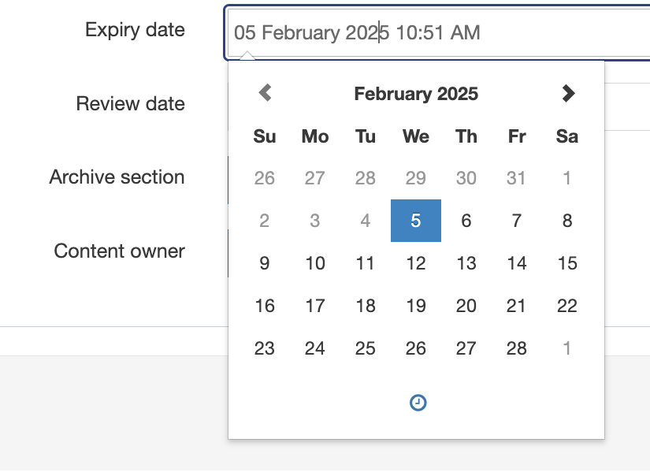
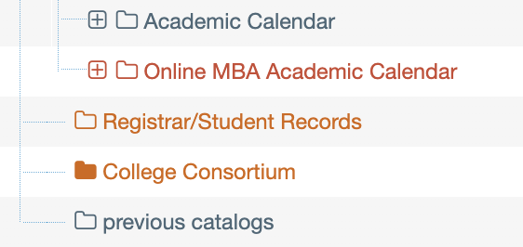



T4 Lingo | Symbols & Buttons on Direct Edit
Lingo
Site Structure/Tree
Direct Edit
Child Section
Breadcrumbs
General Content
Section
Pending
News Story/Event
  Video ID
  Playlist ID
  Teaser
  Body
  Title Category
  Linked Categories
  Featured
  Mirrored Content
  Canonical Link
  Expiry Date
  Preview

Slide 4





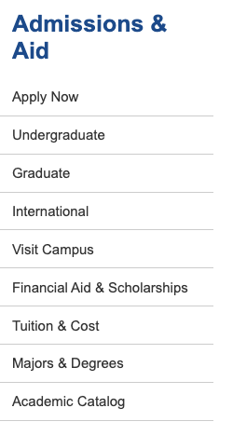
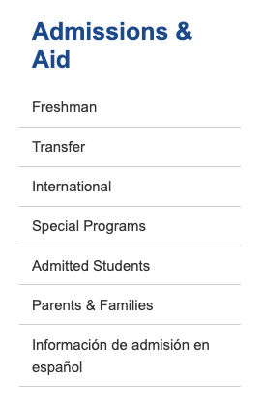

Navigation
Nav
Page 1
Page 2
Page 3
Your Main Page can have a navigation with pages
Each of those pages can then have their own navigation (different from the main page) & sub Navs
See the illustration visual on the right!
Real Example: Admissions & Aid & Undergraduate Admissions
Main Page
[ Nav Page 1 ]
Item 1
Item 2
Sub 1
Sub 2
[ Nav Page 2 ]
Item 1
Sub 1
Sub 2
Item 2
[ Nav Page 3 ]
Item 1
Sub 1
Item 2
Sub 1
Page 1
Page 2
Page 3

Slide 5
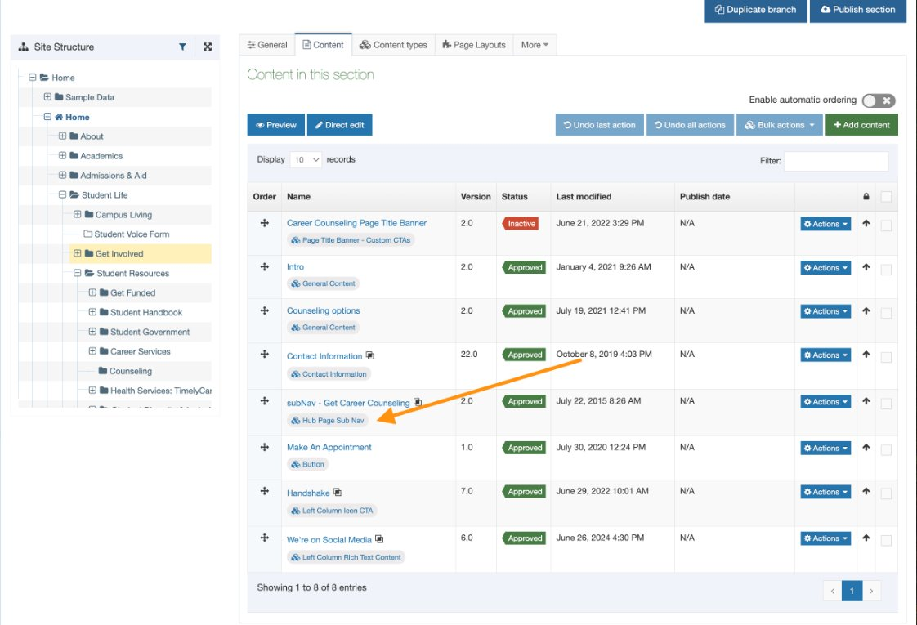
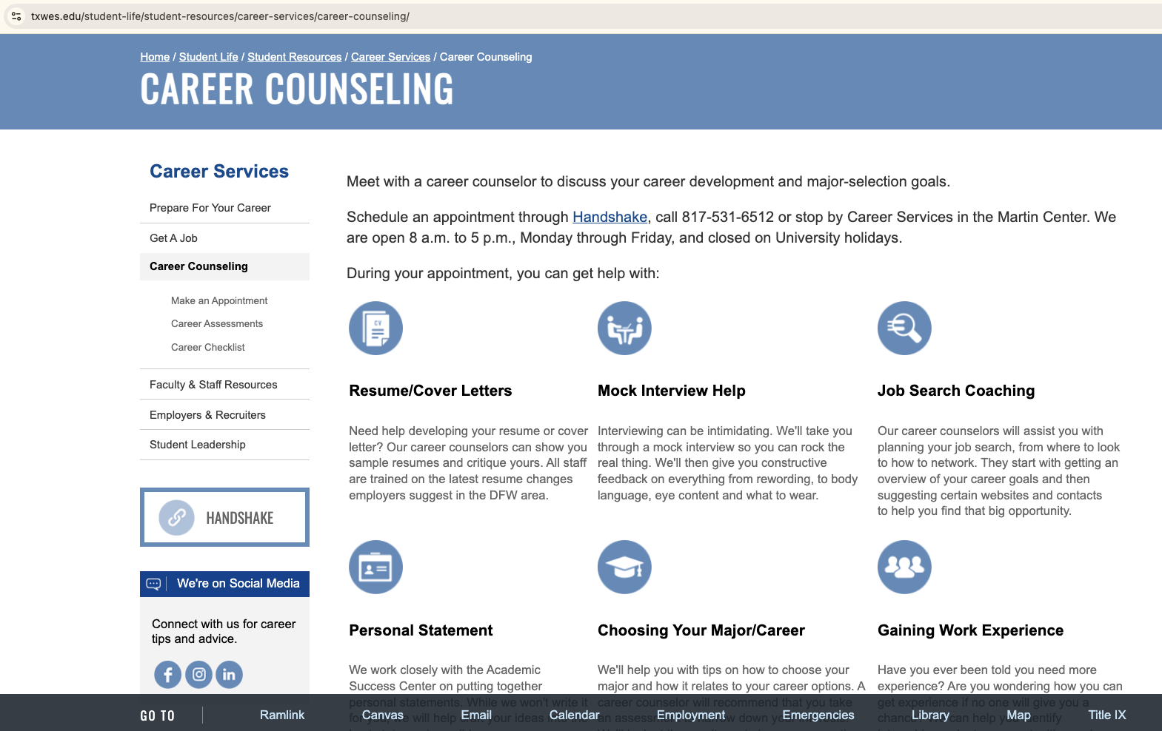
Navigation
Example: Career Counseling
Hub Page SubNav – Content
"Get Career Counseling"

Slide 6
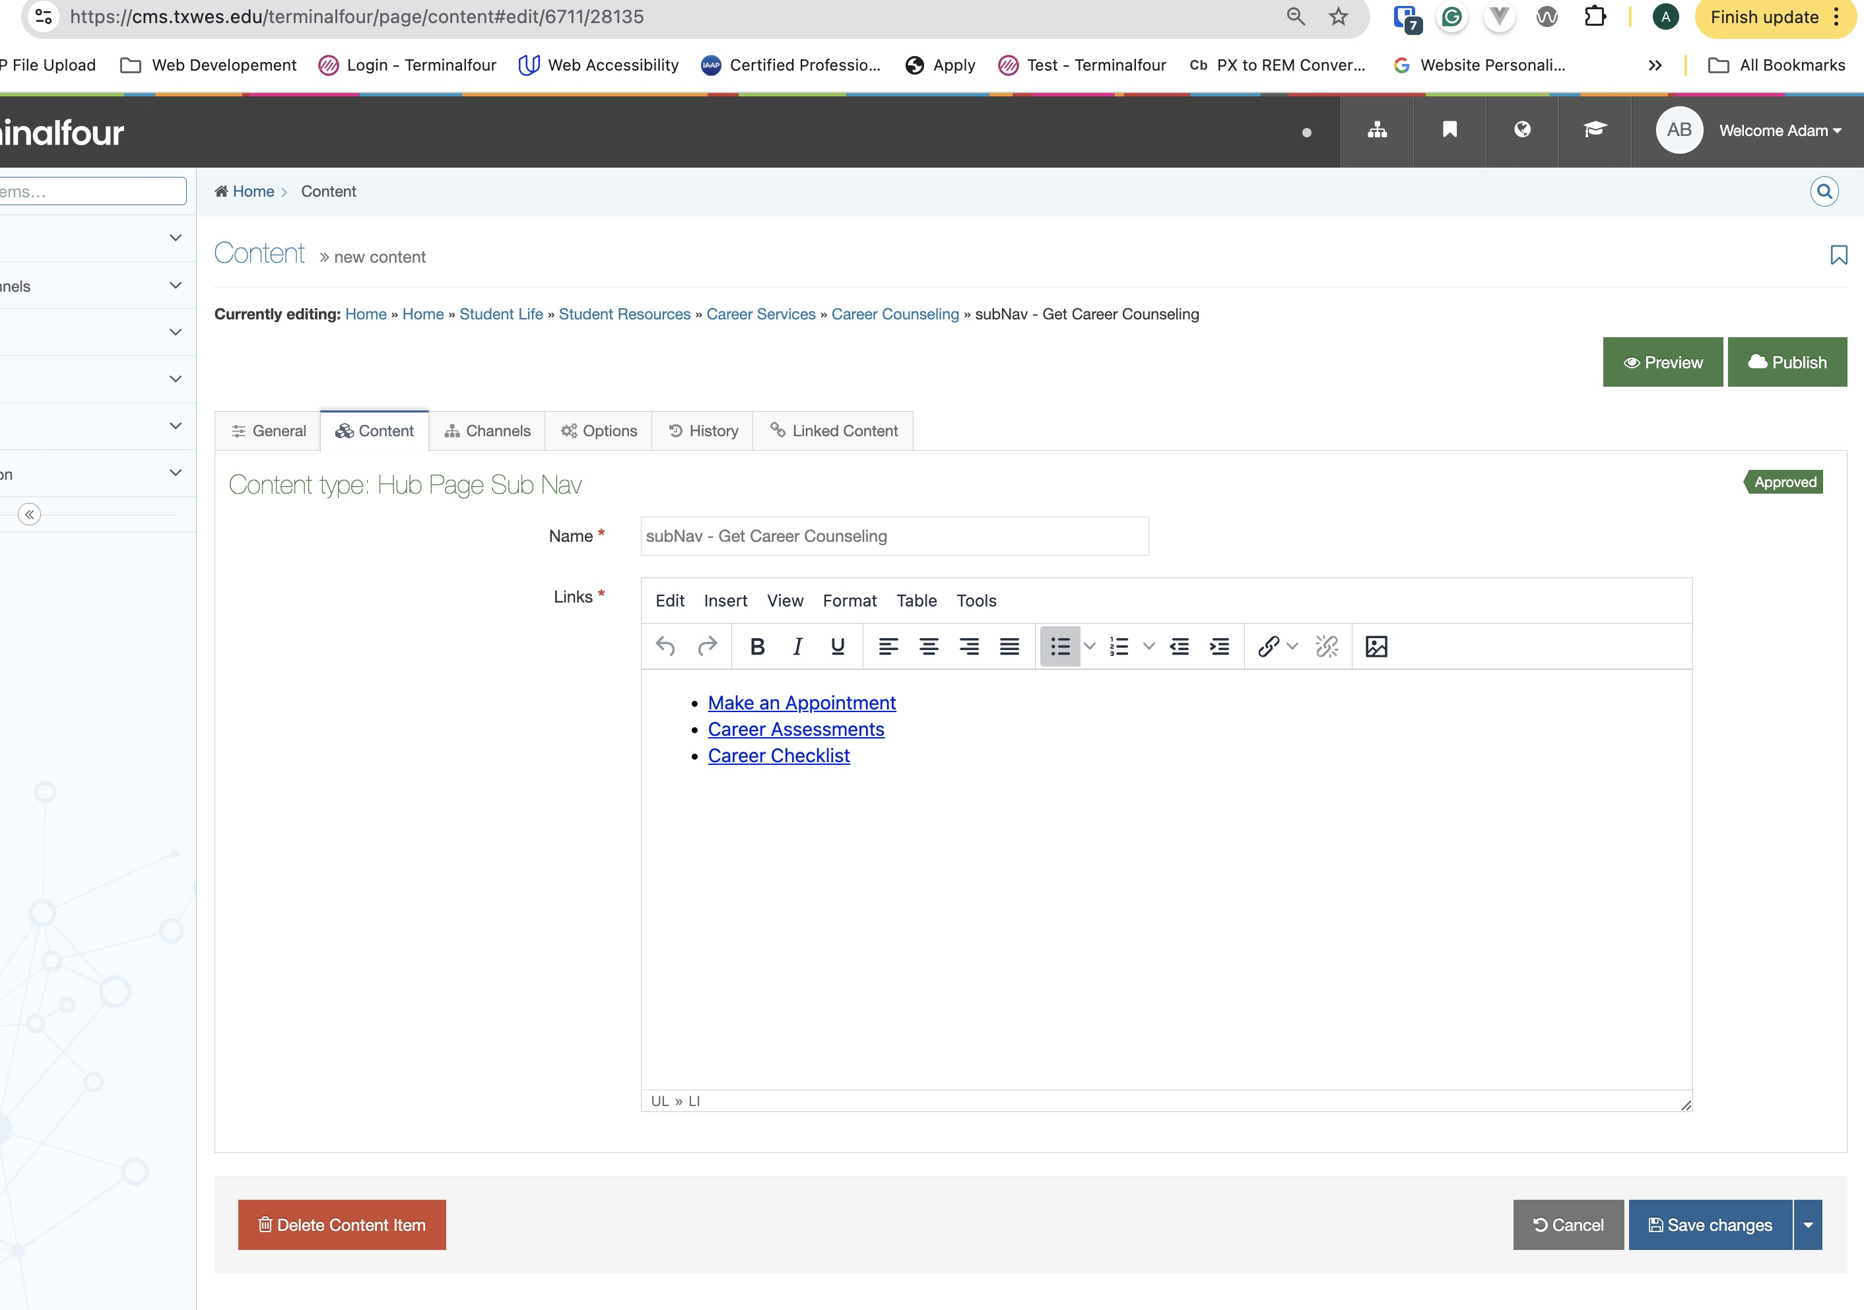

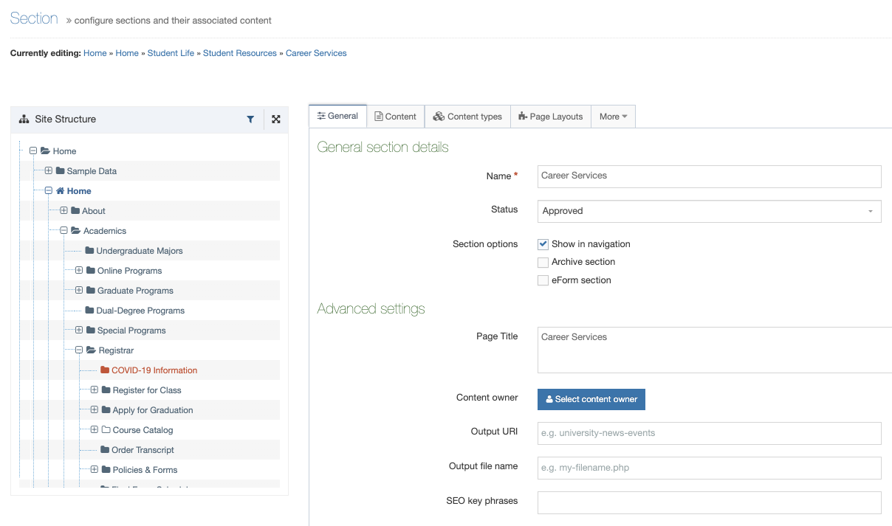
Navigation
Change the sub nav here!
Show a page in Nav here!

Slide 7
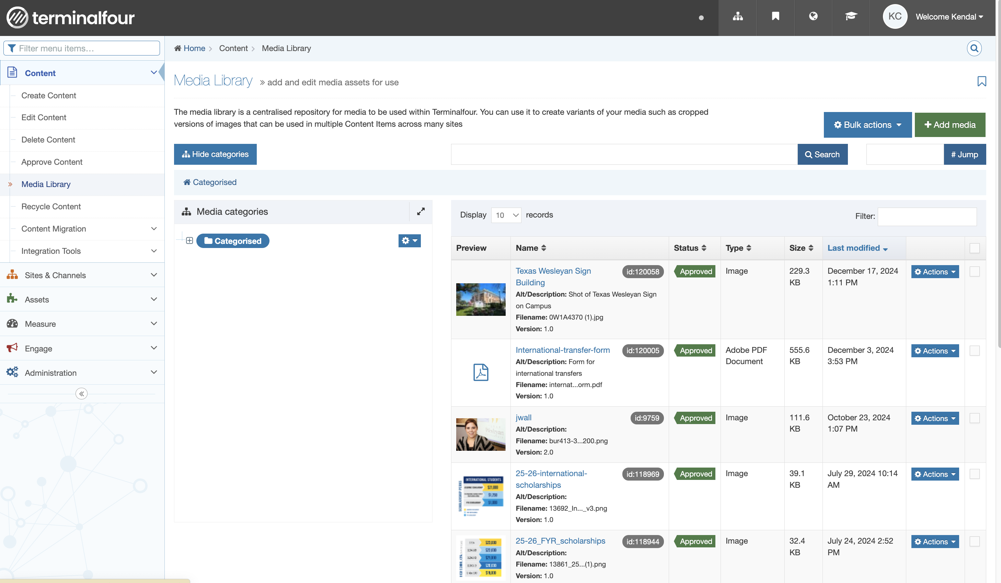
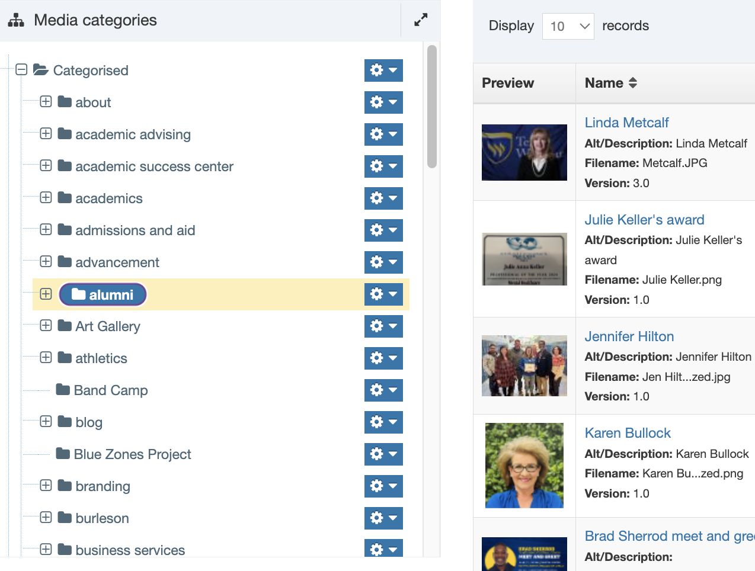

How to Resize Photos in the Media Library
1. Find the image you need to resize
2. Click on the image title

Slide 8
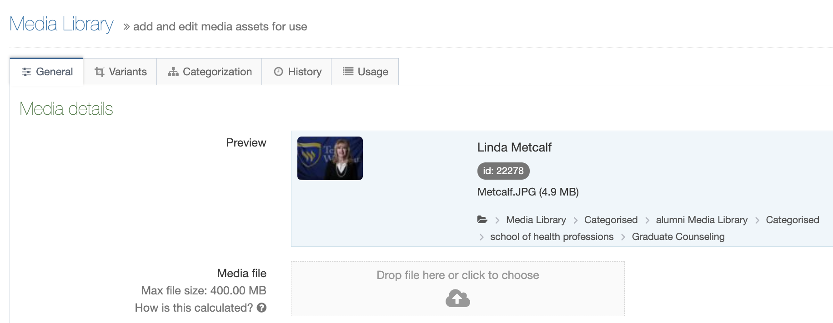
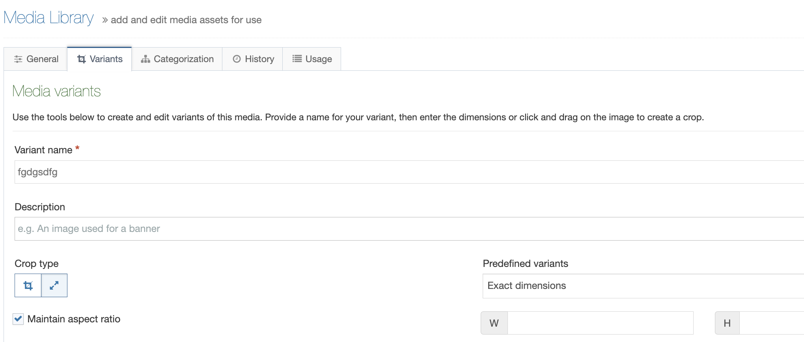
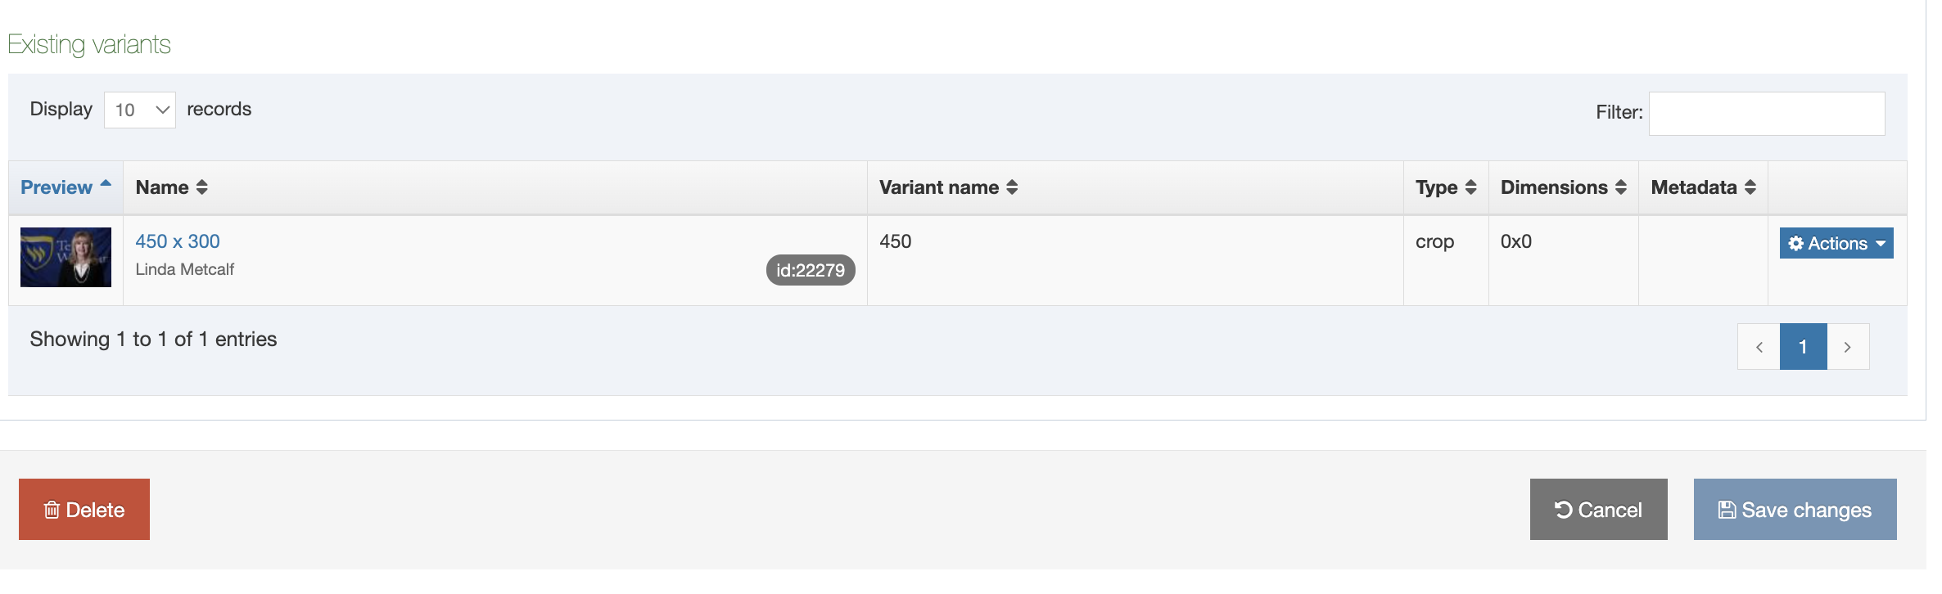
How to Resize Photos in the Media Library
3. Click Variants
4. Title the Variant name
5. Click Arrow Image entitled “Resize”
6. Add Description (Optional)
7. Enter W & H Pixel Sizes
8. Click Save Changes

Slide 9
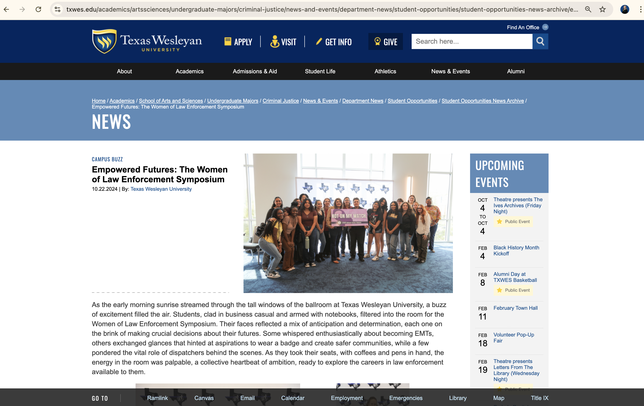
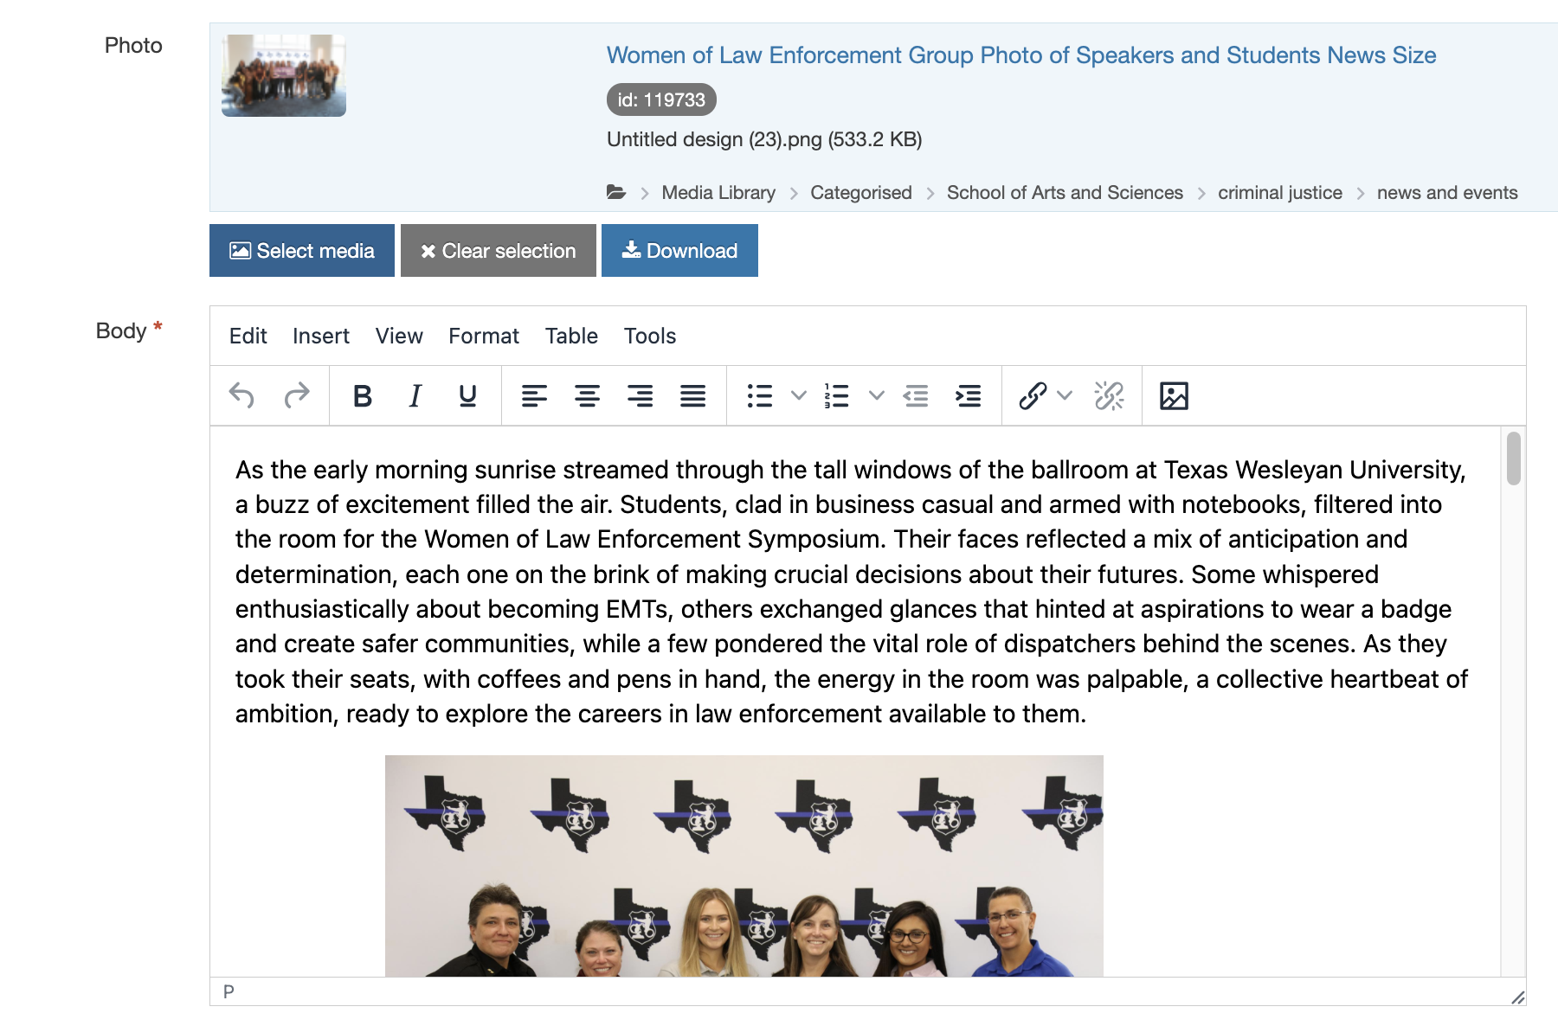
Adding Several Photos to a Content Piece
1. Click the Image box
2. Select the Photo you want to add to the story
3. Add them where you want in the story
Story Example in T4

Slide 10
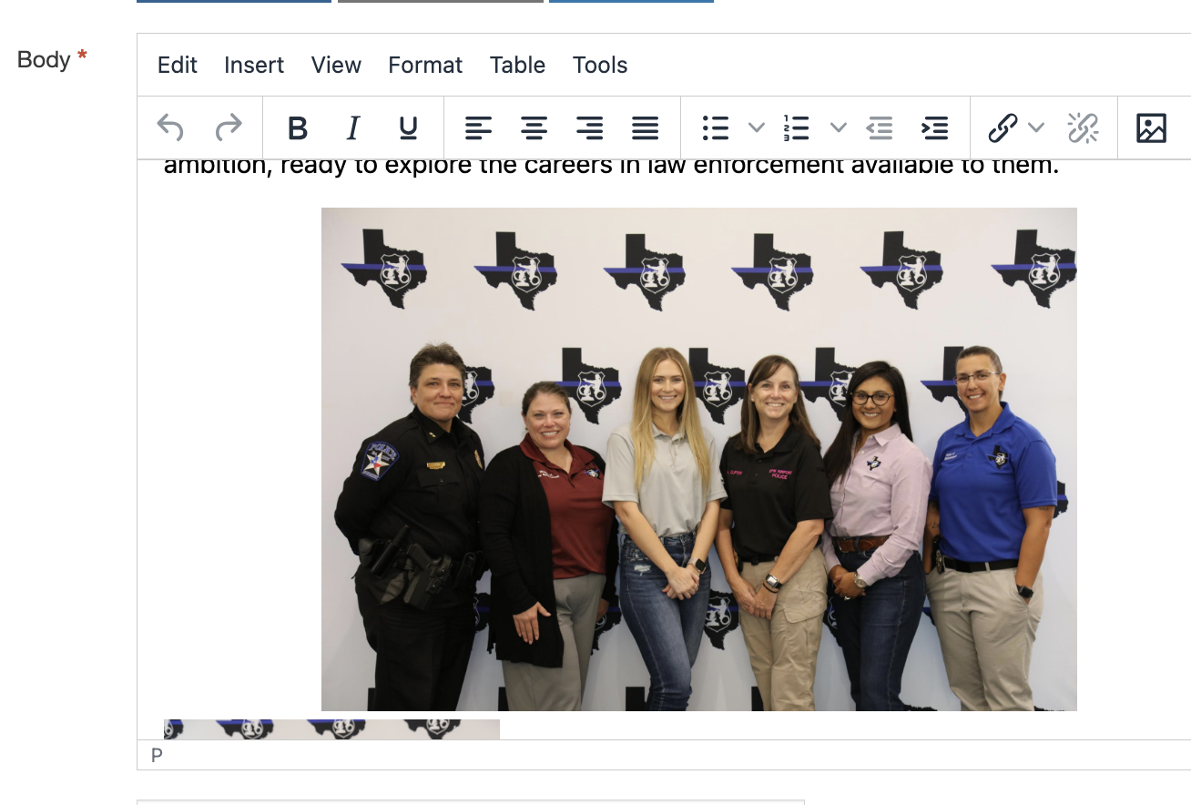
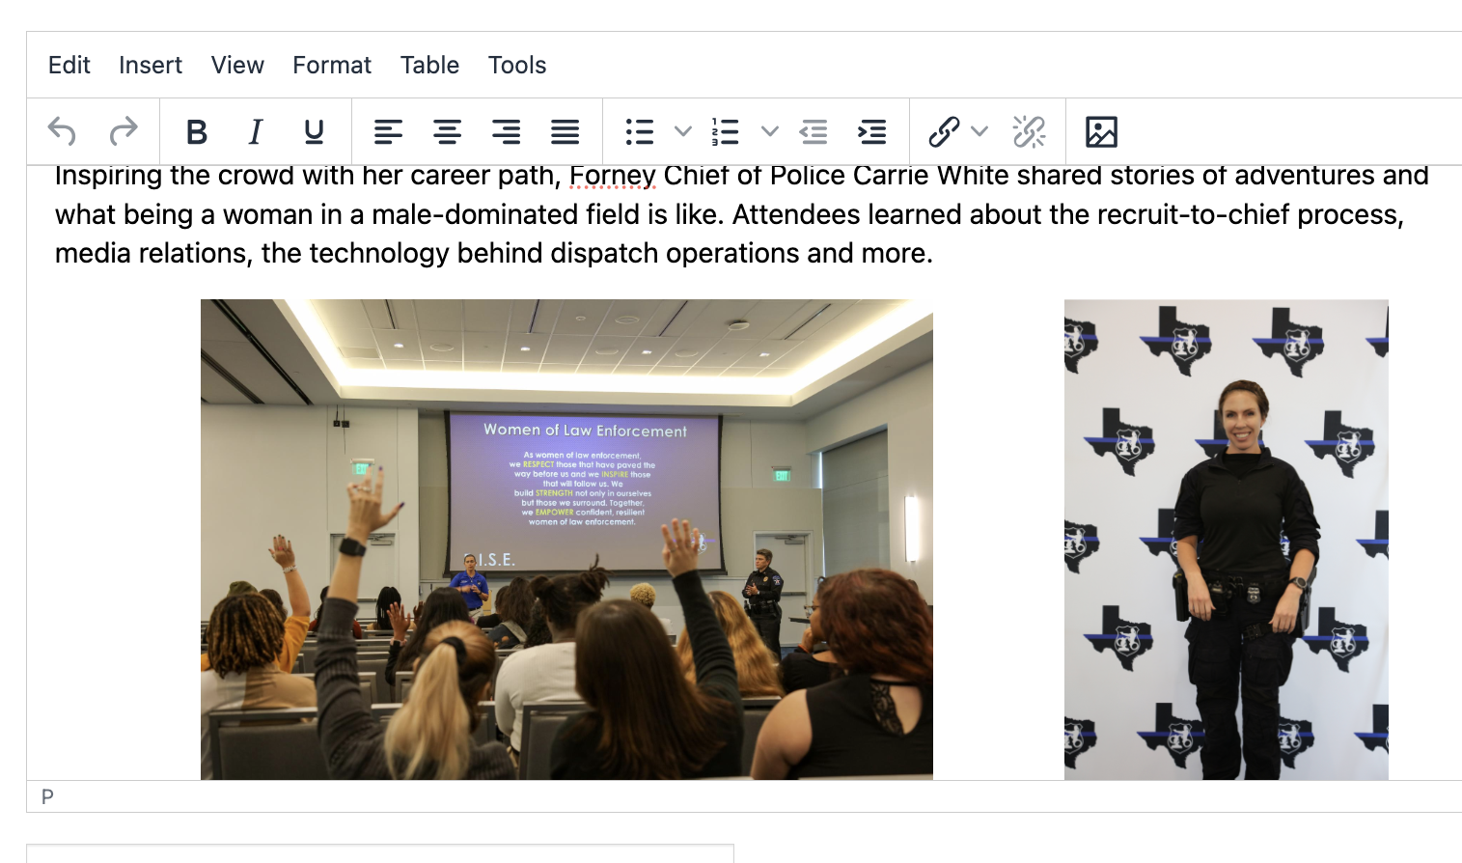
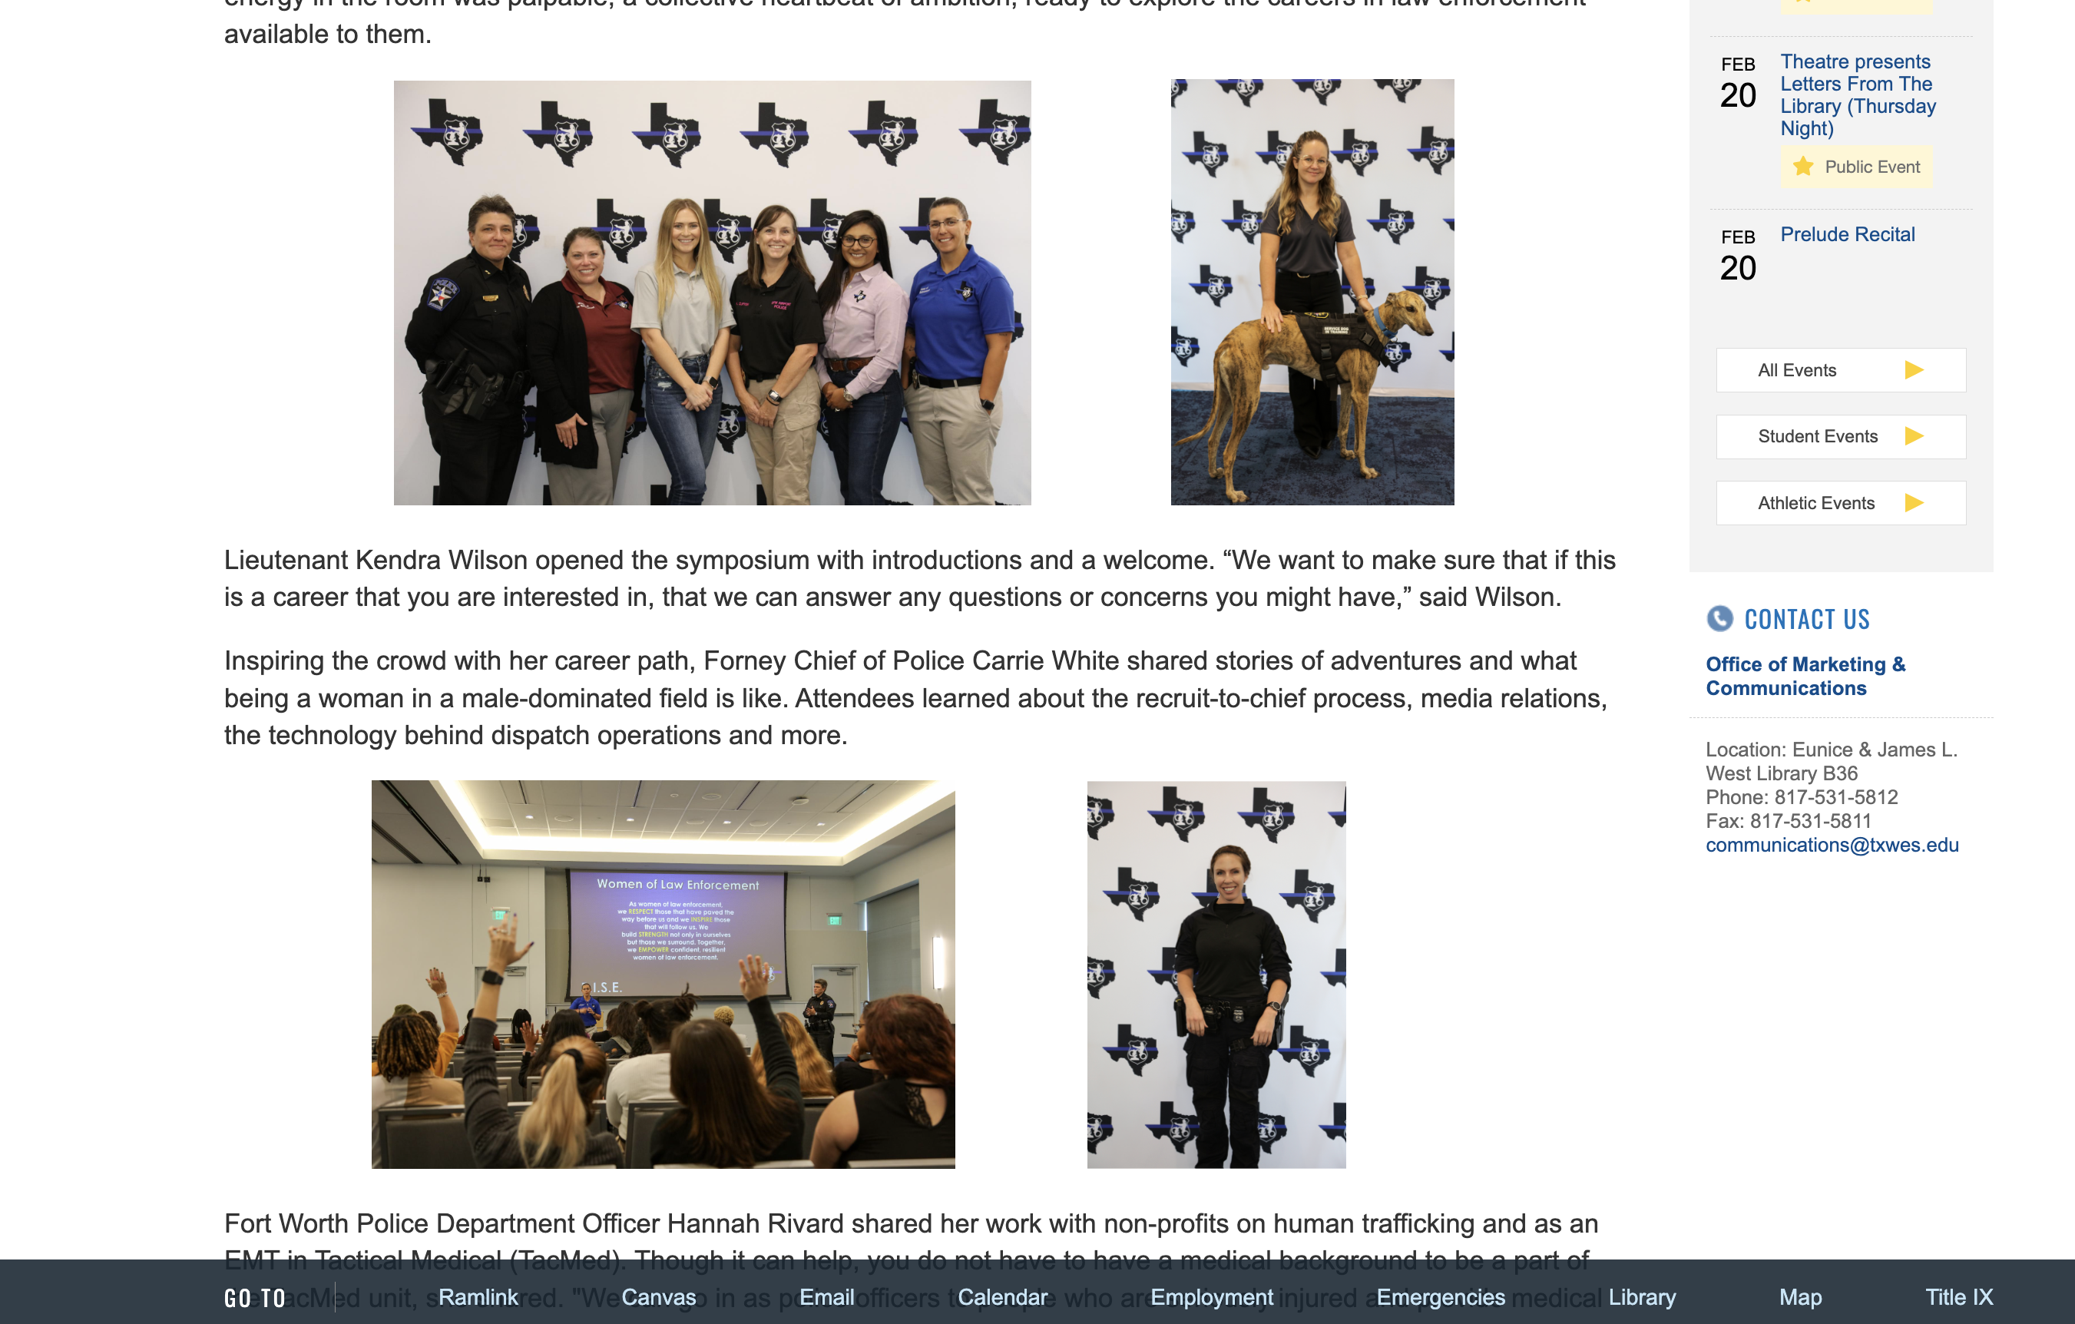
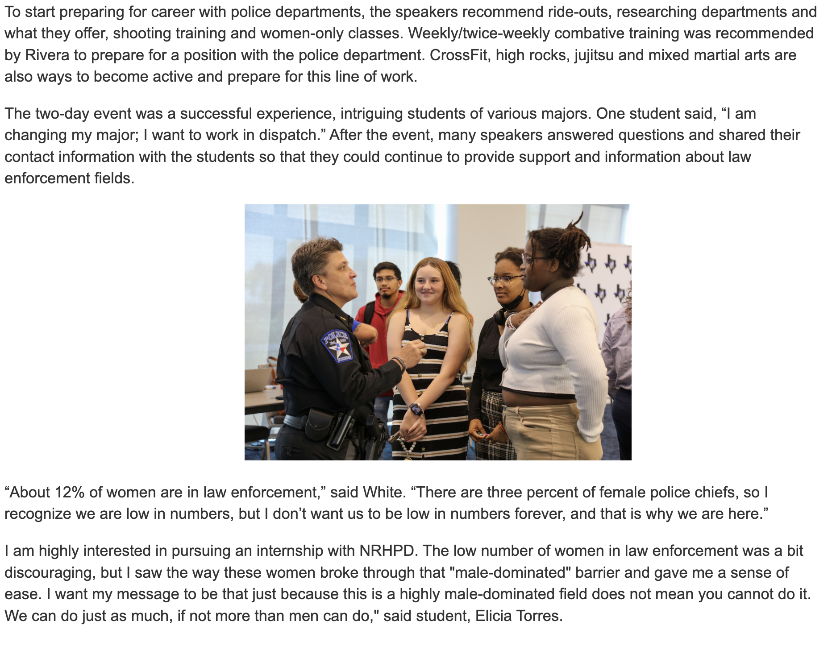
Adding Several Photos to a Content Piece
4. Add Spaces before and after
the photos to space them out
5. Click ”Preview” to view the
story and how the photos look

Slide 11
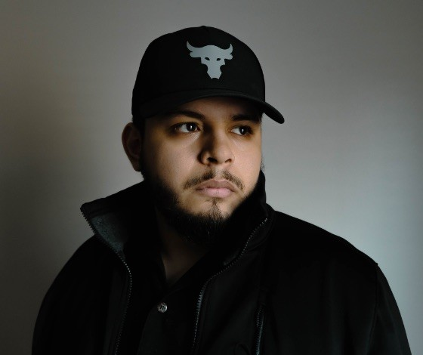
New University Photographer
Christopher Jimenez Jr.
jimenezjr@txwes.edu
Schedule University Headshots:
Home > Communications > University Headshots
https://txwes.edu/communications/university-headshots/

Slide 12
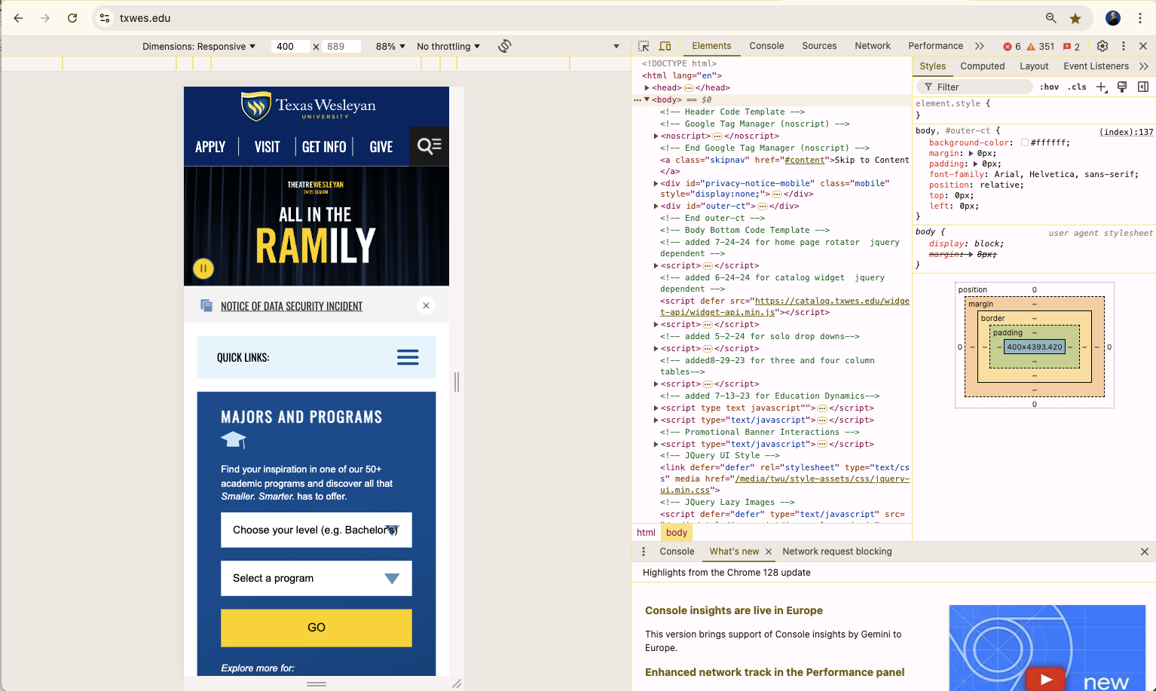
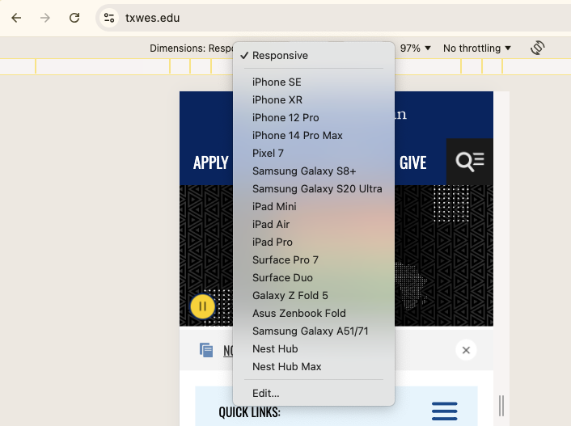
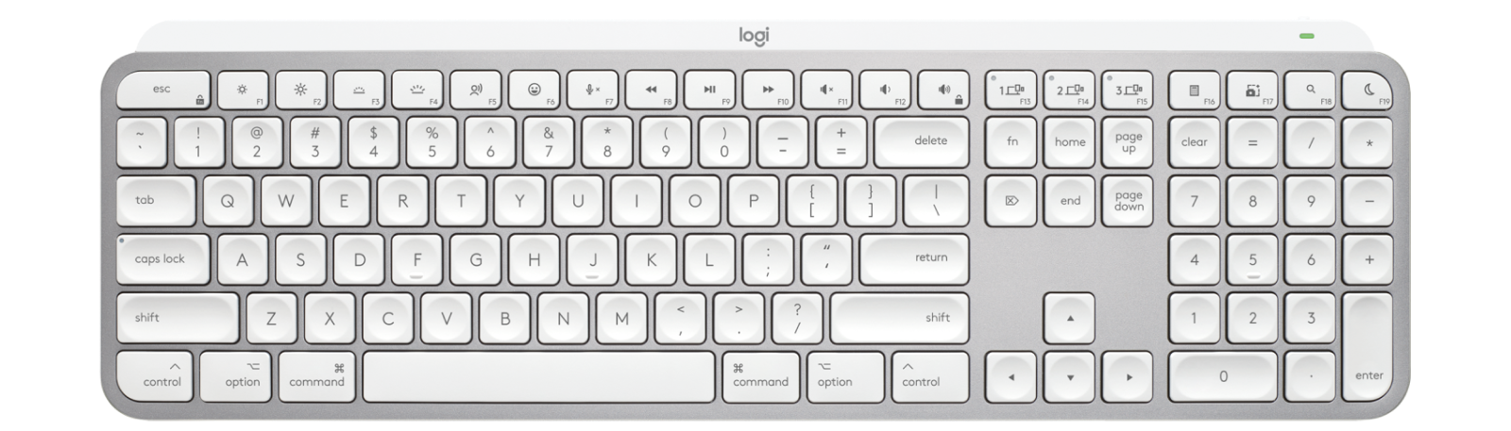
Mobile vs Desktop View
Control Option i
Mac: Command Option i
Change Dimensions
Check your pages & resize as needed!

Slide 13
Updates!
Stock Photos Folder
  Request from us! (PWF)
  Photographer gathering Content
Auto Approve for Your Own Folders
  Coming Soon: Responsibilities Form after Training
  1 to 2 Volunteers for testing
One on One Time is Available
  Schedule a time to meet with us!
  Submit a PWF
  T4 is your oyster!

Slide 14
Thank you! Got Questions?
Contact Us:
Adam Brewer | Web Developer
  abrewer@txwes.edu (T4)
Kendal Clark | SEO Specialist
  kdclark2@txwes.edu (T4)
Candice Soto | Project Manager
  soto@txwes.edu (PWF)
Chris Jimenez | Photographer
  jimenezjr@txwes.edu (Headshots)
Thank you for attending this training!
Please reach out if you have requests for topics to review next time!
Have a larger project you need assistance with from an admin? Submit a PWF request!
Keep up the good work!

