Slide 1
Terminal 4 Training
Module 5 | March 2025
Adam Brewer | Kendal Clark

Slide 2
Overview
Refresh
  Image Sizes
  Link to PDFs
  Clear Your Cache!
  Expire Content
  Add Photos to Content
  Where can I find these T4 presentations?
Learn
  How to make your own stories/events
  T4 Policy

Slide 3
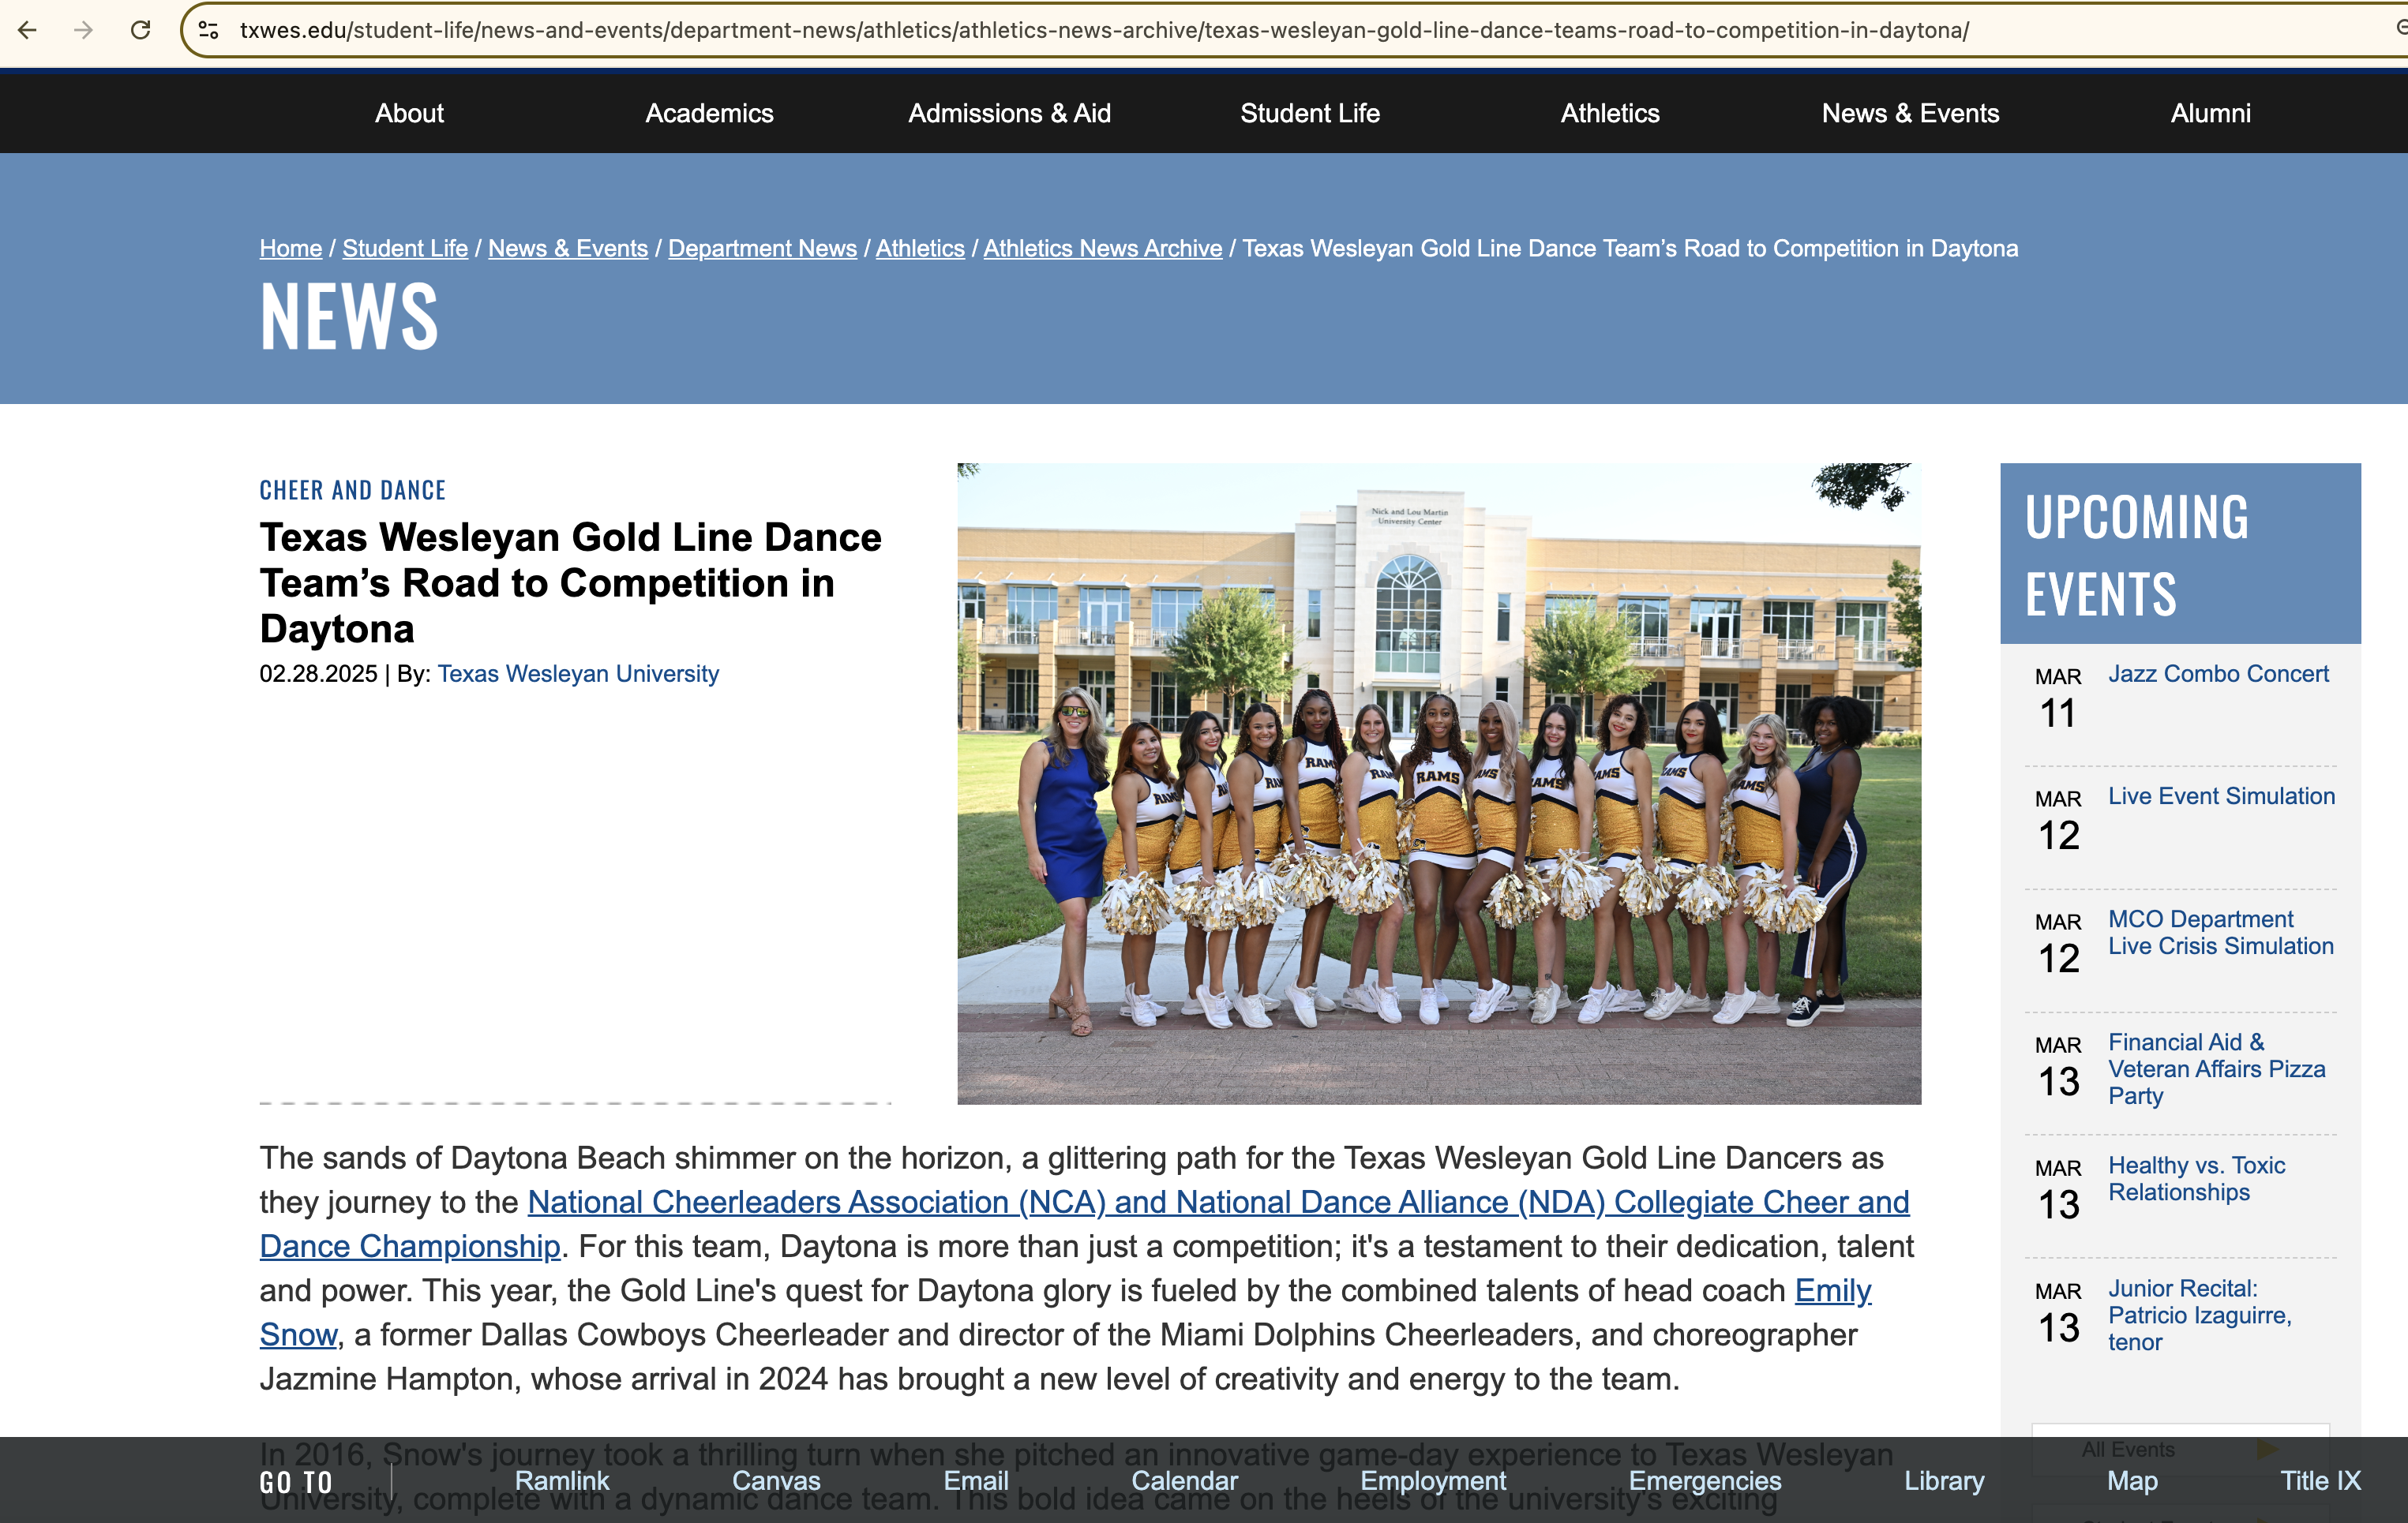
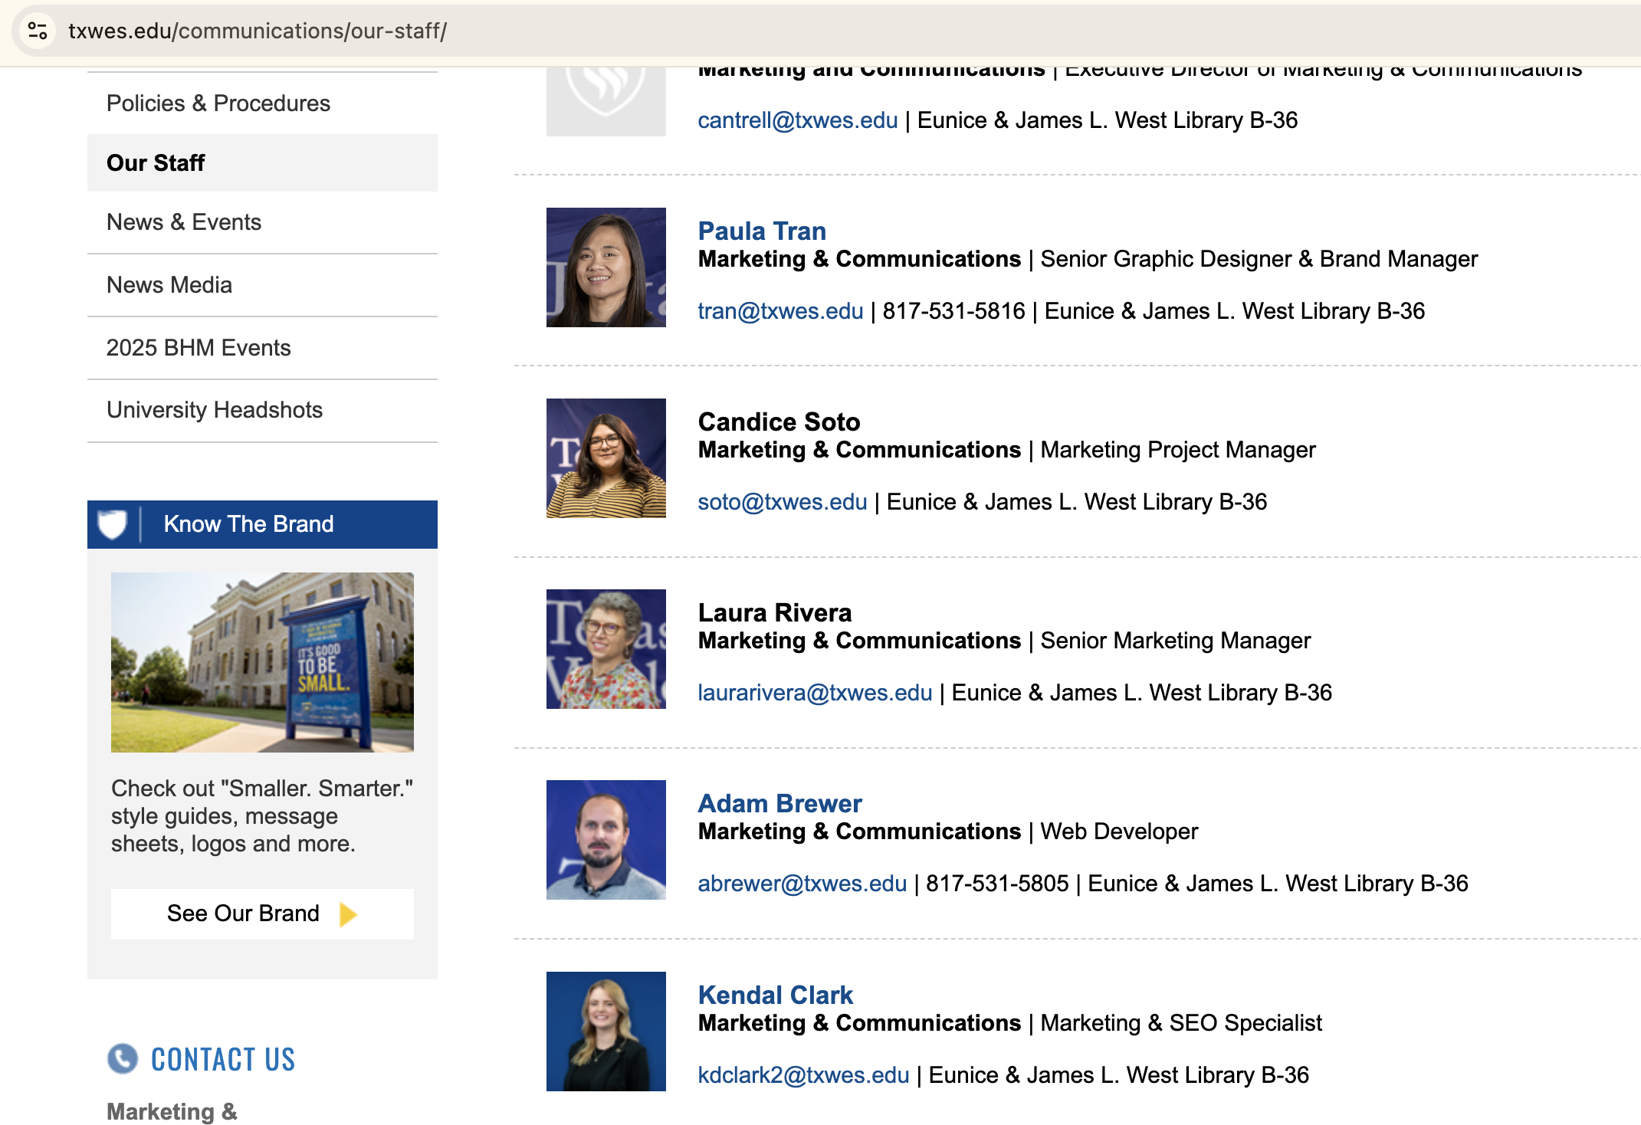
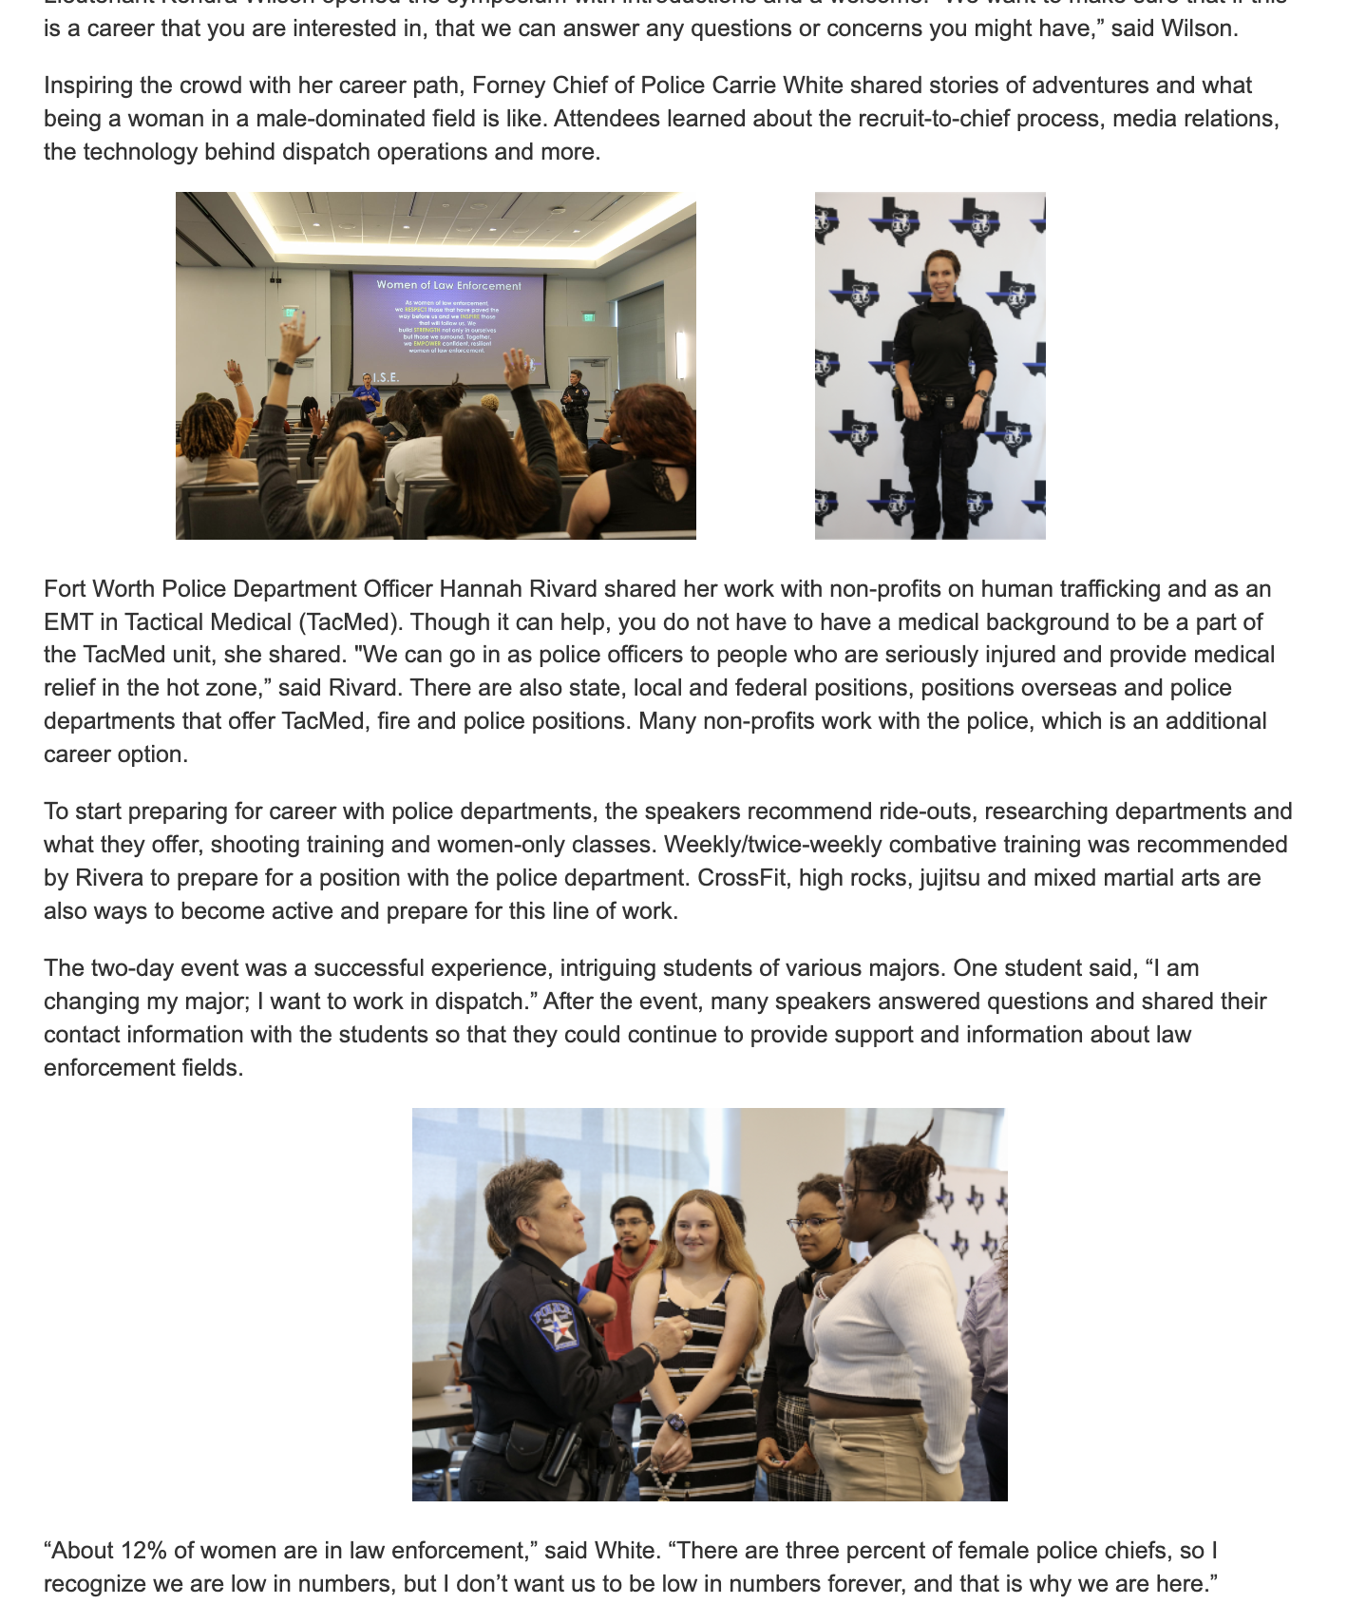
Image Sizes
Appropriate image sizes:
  Story: 690X460 pixels
  Thumbnail: 75X75 pixels
  Story Content: any size!

Slide 4
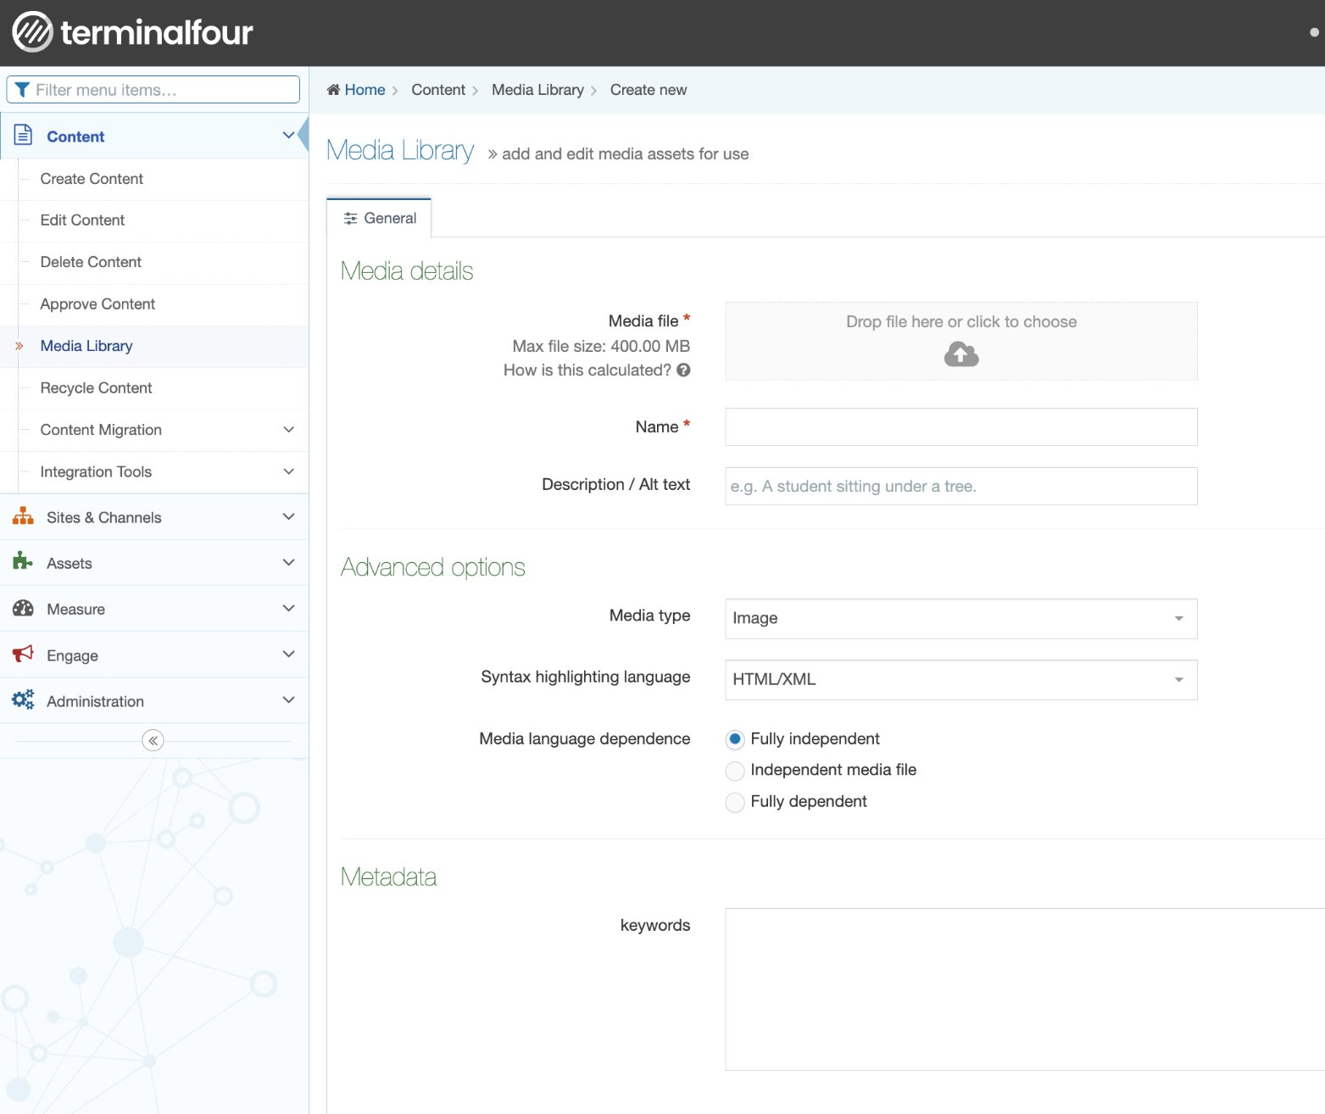
Links to PDFs
1) Open T4
2) Open the Media Library
3) Open the folder where the PDF will live
  (in this example: registrar and forms)
4) Click Add Media
5) Drag the PDF onto the cloud
6) Go to the content piece that needs the PDF in another window
7) Highlight the Words you are linking and click the image square.
8) Search the name of the PDF and click it
9)Save Changes

Slide 5
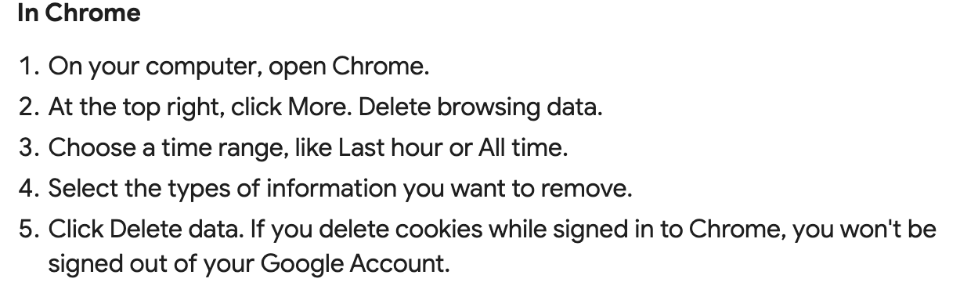
How to Clear Your Cache
It is best to use Chrome when working in T4
If you ever have any issues in T4, always clear your cache first

Slide 6
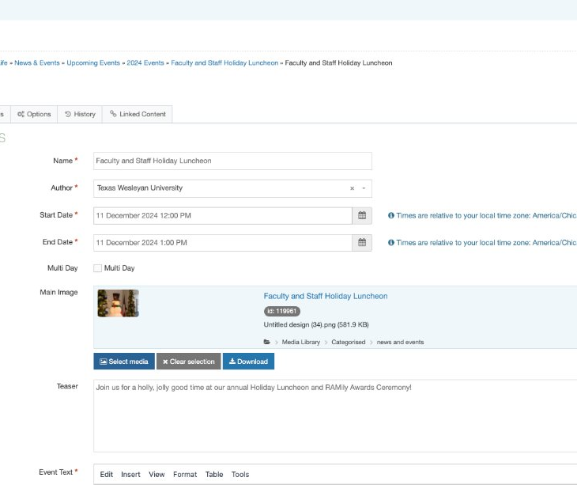
How do I expire content?
Event Example​
  Log onto T4​
  Begin uploading or editing the content​
  Go to the "Options" tab​ at the top
  See "Expiry Date"​
  Change the Date and make the date the next day at 11:59 p.m.
  Save Changes
  Do this in order to avoid future broken links, or needing to clean up everything.

Slide 7
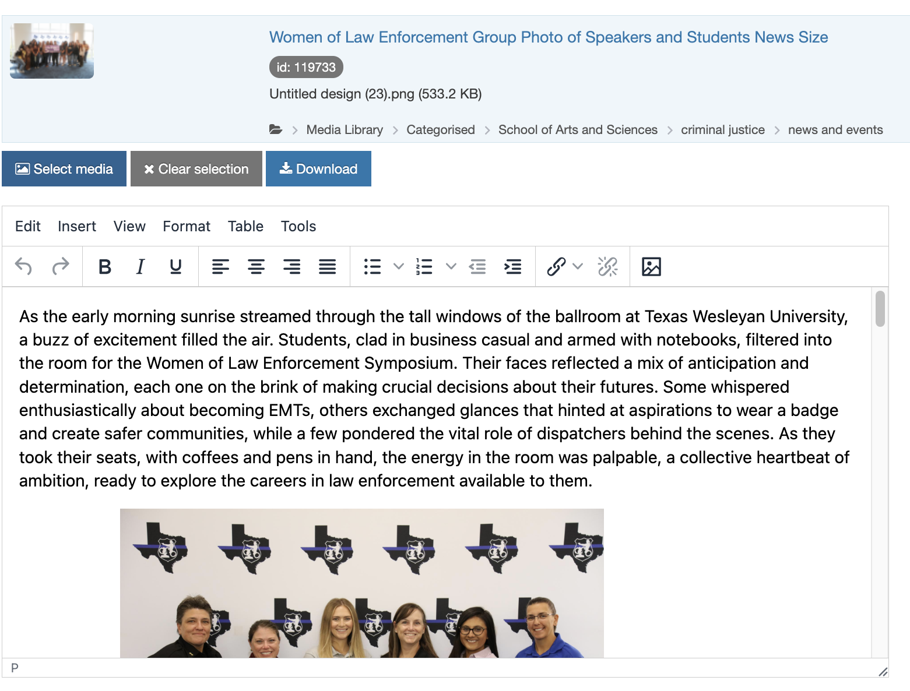
Adding Several Photos to a Content Piece
1. Click the Image box
2. Select the Photo you want to add to the story
3. Add them where you want in the story
4. Add Spaces before and after
the photos to space them out
5. Click ”Preview” to view the
story and how the photos look

Slide 8
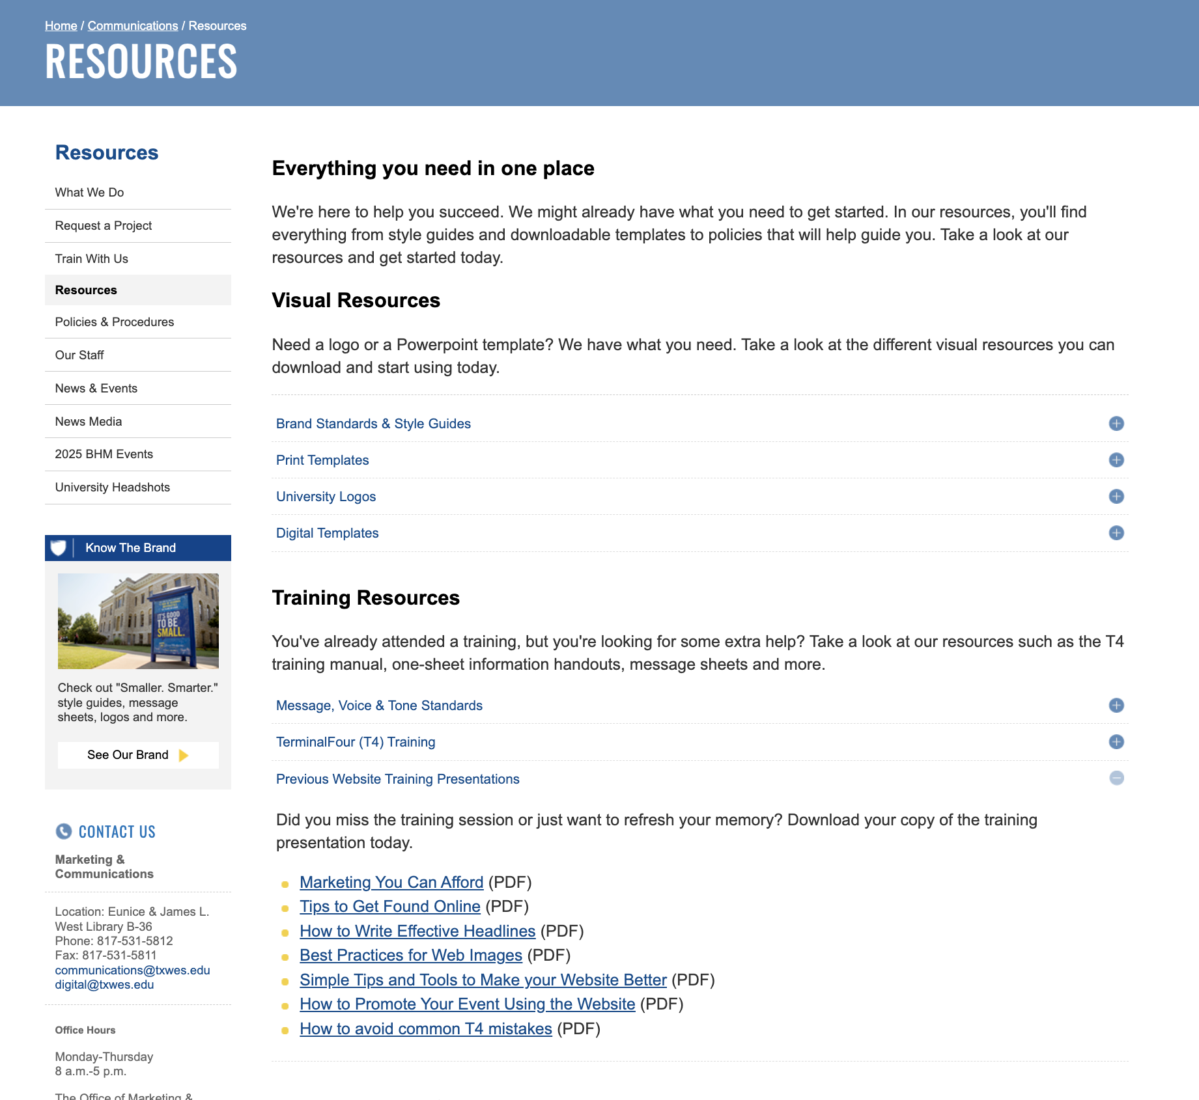
Where can I find the T4 presentations?
https://txwes.edu/communications/resources/
See “Previous Website Training Presentations” on the Communication Resources page

Slide 9
How to Make Your Own Events
1. Go to T4
2. Go to that Department’s news and events section (see “options” and “child sections” or use the copyright symbol on the page)
3. Add Section
4. Name the event (less than 80 characters)
5. Click “Save and Edit Section”
6. Click “Add Content”
7. In the filer box, put “TXWES Event” and select that option
8. Add the name and information- title, date, times, Teaser, photo in News Size, Location, Expiry Date and section link.
(To add Section Links, click ”Add Section Link” and in the filter box, paste the title of the event

Slide 10
How to Make Your Own News Story
1. Go to T4
2. Go to that Department’s news and events section (see “options” and “child sections” or use the copyright symbol on the page)
3. Add Section
4. Name the story (less than 80 characters)
5. Click “Save and Edit Section”
6. Click “Add Content”
7. In the filer box, put “News Story” and select that option
8. Add the name and information- title, date, times, Teaser, photo in News Size, Location, Expiry Date and section link.
(To add Section Links, click ”Add Section Link” and in the filter box, paste the title of the story

Slide 11
Thank you! Got Questions?
Contact Us:
Adam Brewer | Web Developer
  abrewer@txwes.edu (T4)
Kendal Clark | SEO Specialist
  kdclark2@txwes.edu (T4)
Candice Soto | Project Manager
  soto@txwes.edu (PWF)
Chris Jimenez | Photographer
  jimenezjr@txwes.edu (Headshots)
Thank you for attending this training!
Have a larger project you need assistance with from an admin? Submit a PWF request!
Keep up the good work!

